Slide 1
Improving Modern Techniques of Causal Inference: Finite Sample Performance of ATM and ATO Doubly Robust Estimators, Variance Estimation for ATO Estimators, and Contextualized Tipping Point Sensitivity Analyses for Unmeasured Confounding
Lucy D’Agostino McGowan

Slide 2
Exploring finite-sample bias in propensity score weighting choices

Slide 3

Observational Studies
exposure
outcome

Slide 4
Observational Studies
Randomized Controlled Trials
Treatment
P=0.5
Control
P=0.5

Slide 5
Observational Studies
Treatment
P=0.9
Control
P=0.1

Slide 6
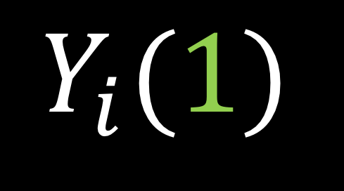

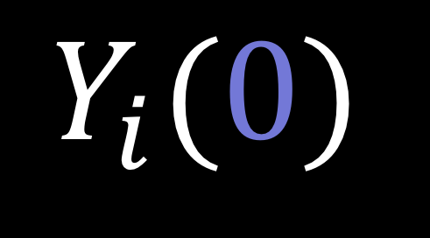
Potential outcomes
$$Y_{i}(0)$$
$$Y_{i}(1)$$
$$−$$
Notes:
In a study such as this, there are two potential outcomes for an individual I, Y i 0, _click_ the outcome if they are assigned the control and Y i 1, _click_ the outcome if they are assigned the treatment. Often our estimate of interest is the _click_ difference between these two outcomes. In reality, however only one of these two quantities is observable.

Slide 7
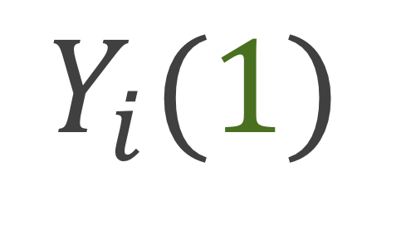
Potential outcomes
$$Y_{i}(0)$$
$$Y_{i}(1)$$
Notes:
If you are assigned the control, we can observe you Y i (0)

Slide 8
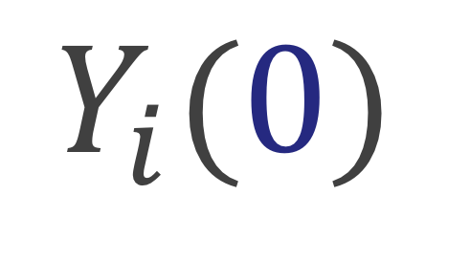
Potential outcomes
$$Y_{i}(0)$$
$$Y_{i}(1)$$
Notes:
And if you are assigned the treatment we can observe your Y i 1. This is often handled fundamentally as a missing data problem. While only one of these paired outcomes is observed, we can estimate what the other, the counterfactual, would have been had the participant received the opposite treatment.

Slide 9
Potential outcomes
$$Y_{i}(0)$$
$$Y_{i}(1)$$
$$−$$
Notes:
Ultimately, we are interested in some estimate of the treatment effect, for example we may want to know what the average treatment effect is across all participants, or we may want to know what the average treatment effect is among participants who received the treatment. I’m going to show you a few of these causal estimands and how we can estimate them using specific weights

Slide 10
Causal Quantities

Slide 11

Average treatment effect
$$E[Y\left(1\right)−Y\left(0\right)]$$

Slide 12

Average treatment effect
$$\frac{1}{n}\sum_{i=1}^{n}{Y_{i}Z_{i}}−\frac{1}{n}\sum_{i=1}^{n}{Y_{i}(1−Z_{i})}$$
Notes:
In a randomized setting, we can just take the the difference between the mean outcome among the treated and the mean outcome among the controls

Slide 13

No unmeasured confounders
$$\left(Y\left(0\right),Y\left(1\right)\right)⊥Z|X$$
Notes:
In the observational study setting, given that there are no unmeasured confounders, which is often written in this way, that the potential outcomes are independent of treatment assignment given X, we can use propensity scores to estimate the average treatment effect

Slide 14

Propensity score
$$e_{i}=P(Z_{i}=1|X)$$
Notes:
the probability that you received treatment given your observed pre-treatment covariates. A lot of times we fit this with a logistic regression

Slide 15

Average treatment effect
$$w_{ATE}=\frac{Z_{i}}{e_{i}}+\frac{{1 −Z}_{i}}{1 −e_{i}}$$

Slide 16
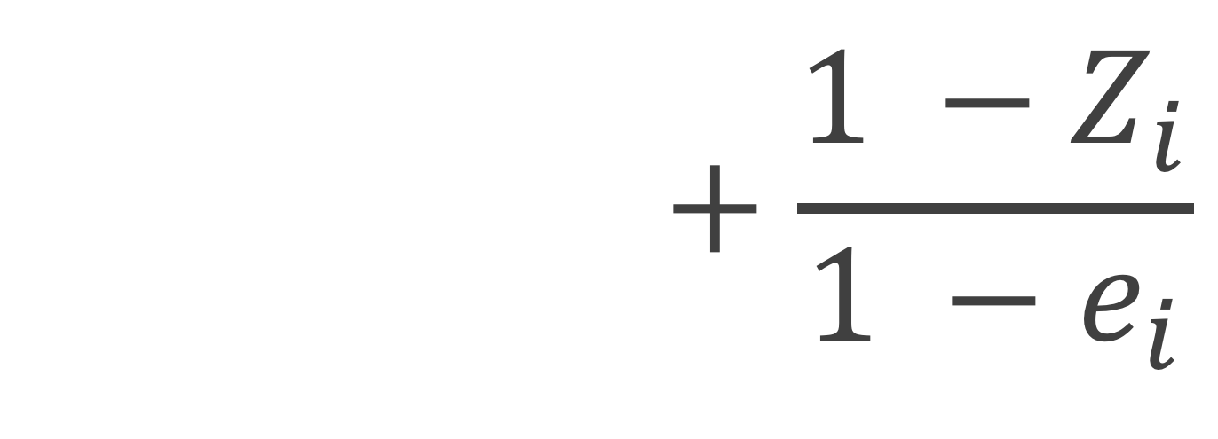
Average treatment effect
$$w_{ATE}=\frac{Z_{i}}{e_{i}}+\frac{{1 −Z}_{i}}{1 −e_{i}}$$

Slide 17

Average treatment effect
$$w_{ATE}=\frac{Z_{i}}{e_{i}}+\frac{{1 −Z}_{i}}{1 −e_{i}}$$

Slide 18

Average treatment effect
$$\frac{\sum_{i=1}^{n}{Y_{i}Z_{i}w_{i}}}{\sum_{i=1}^{n}{Z_{i}w_{i}}}−\frac{\sum_{i=1}^{n}{Y_{i}\left(1−Z_{i}\right)w_{i}}}{\sum_{i=1}^{n}{\left(1−Z_{i}\right)w_{i}}}$$
Notes:
In a randomized setting, we can just take the the difference between the mean outcome among the treated and the mean outcome among the controls

Slide 20

Average treatment effect among the treated
$$E\left[Y\left(1\right)−Y\left(0\right)\right|Z=1]$$

Slide 21

Average treatment effect among the treated
$$w_{ATT}=\frac{e_{i}Z_{i}}{e_{i}}+\frac{e_{i}\left(1−Z_{i}\right)}{1 −e_{i}}$$

Slide 23

Average treatment effect among the controls
$$E\left[Y\left(1\right)−Y\left(0\right)\right|Z=0]$$

Slide 24

Average treatment effect among the controls
$$w_{ATC}=\frac{\left(1−e_{i}\right)Z_{i}}{e_{i}}+\frac{\left(1−e_{i}\right)\left(1−Z_{i}\right)}{1−e_{i}}$$

Slide 26

Average treatment effect among the evenly matchable
$$E\left[Y\left(1\right)−Y\left(0\right)\right|M_{d}=1]$$
Notes:
Here, the ATM depends on some distance measure d to determine whether each participant is deemed “evenly matchable”, Md=1. The less prevalent exposure in any region of the covariate space, as defined by d, is matchable in the sense that they would readily find mates in a 1:1 within-caliper matching without replacement.
This estimand was defined by Laurie in her dissertation a last year.
?? In contrast, the more prevalent exposure(s) could not all find mates in this matching scheme. ??

Slide 27

Average treatment effect among the evenly matchable
$$w_{ATM}=\frac{min\left\{e_{i}, 1−e_{i}\right\}}{{e_{i}Z}_{i}+(1 −e_{i})(1−Z_{i})}$$
Minimum of ATT and ATC weights (Samuels 2017)

Slide 29

Average treatment effect among the overlap population
$$w_{ATO}=\left(1−e_{i}\right)Z_{i}+ e_{i}(1−Z_{i})$$

Slide 31
ATE
ATT
ATC
ATM
AT0

Slide 32
ATE
ATT
ATC
ATM
AT0

Slide 33
ATE
ATT
ATC
ATM
AT0

Slide 34
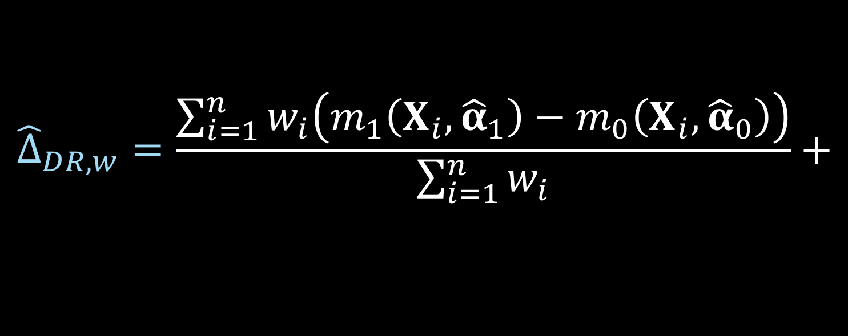


Doubly robust estimator
$${\hat{Δ}}_{DR, w}=\frac{\sum_{i=1}^{n}{w_{i}\left(m_{1}\left(X_{i},{\hat{α}}_{1}\right)−m_{0}\left(X_{i}, {\hat{α}}_{0}\right)\right)}}{\sum_{i=1}^{n}{w_{i}}}+$$
$$\frac{\sum_{i=1}^{n}{w_{i}Z_{i}\left(Y_{i}−m_{1}\left(X_{i}, {\hat{α}}_{1}\right)\right)}}{\sum_{i=1}^{n}{w_{i}}Z_{i}}−$$
$$\frac{\sum_{i=1}^{n}{w_{i}{(1−Z}_{i})\left(Y_{i}−m_{0}\left(X_{i}, {\hat{α}}_{0}\right)\right)}}{\sum_{i=1}^{n}{w_{i}}(1−Z_{i})}$$
Notes:
_click_ these ws are the weights we’ve just defined _click_
_click_ m1 is the predicted y value, calculated using the model built on the treated participants _click_
_click_ and m0 is the predicted y value, calculated using the model built on the participants assigned to the control group

Slide 35
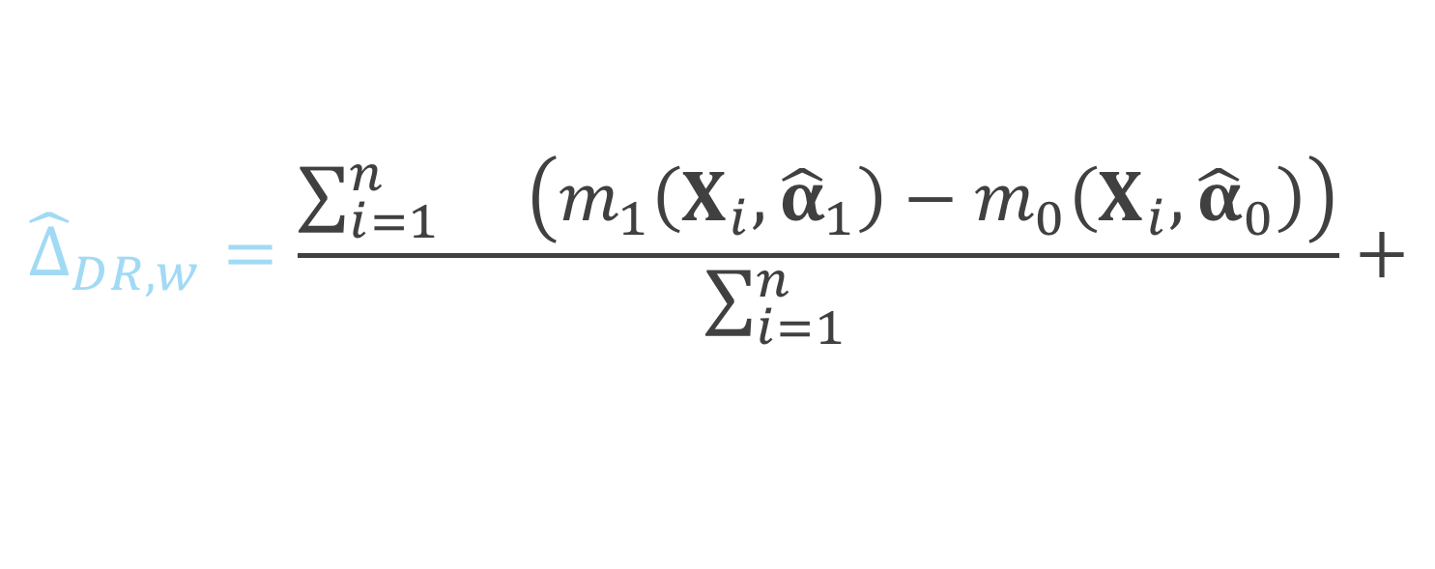
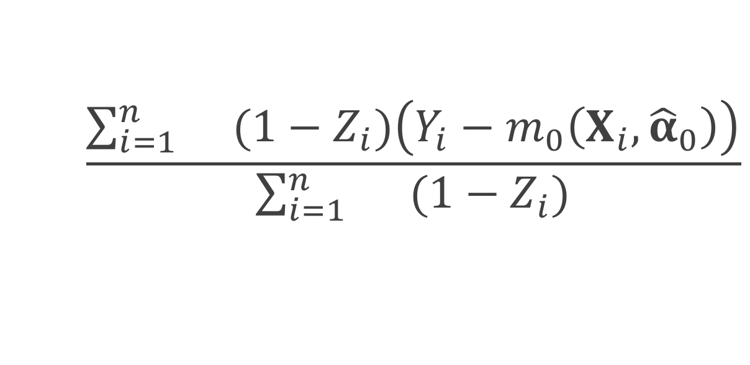
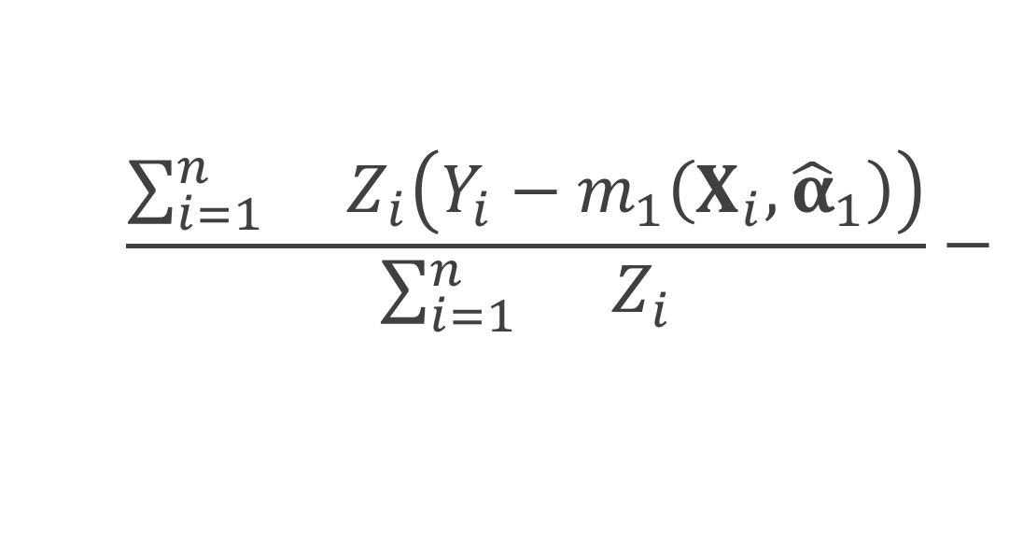
Doubly robust estimator
$${\hat{Δ}}_{DR, w}=\frac{\sum_{i=1}^{n}{w_{i}\left(m_{1}\left(X_{i},{\hat{α}}_{1}\right)−m_{0}\left(X_{i}, {\hat{α}}_{0}\right)\right)}}{\sum_{i=1}^{n}{w_{i}}}+$$
$$\frac{\sum_{i=1}^{n}{w_{i}Z_{i}\left(Y_{i}−m_{1}\left(X_{i}, {\hat{α}}_{1}\right)\right)}}{\sum_{i=1}^{n}{w_{i}}Z_{i}}−$$
$$\frac{\sum_{i=1}^{n}{w_{i}{(1−Z}_{i})\left(Y_{i}−m_{0}\left(X_{i}, {\hat{α}}_{0}\right)\right)}}{\sum_{i=1}^{n}{w_{i}}(1−Z_{i})}$$
Notes:
_click_ these ws are the weights we’ve just defined _click_
_click_ m1 is the predicted y value, calculated using the model built on the treated participants _click_
_click_ and m0 is the predicted y value, calculated using the model built on the participants assigned to the control group

Slide 36
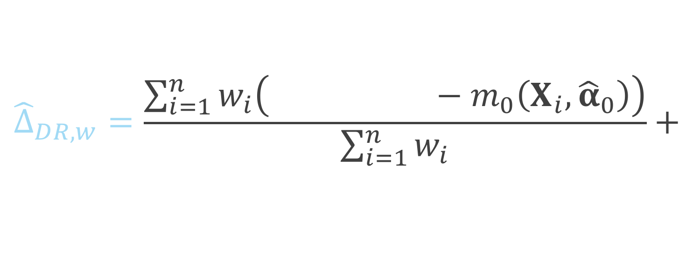
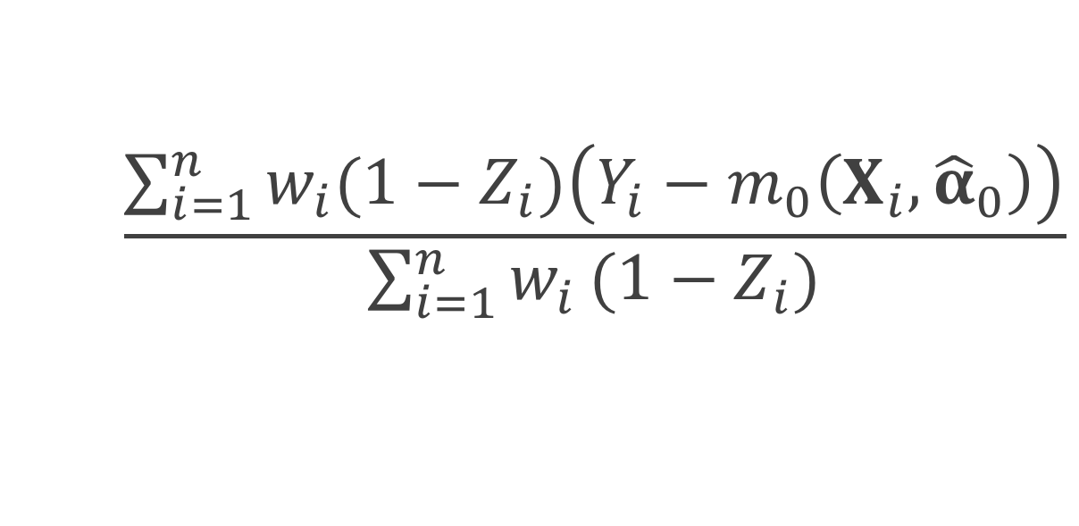
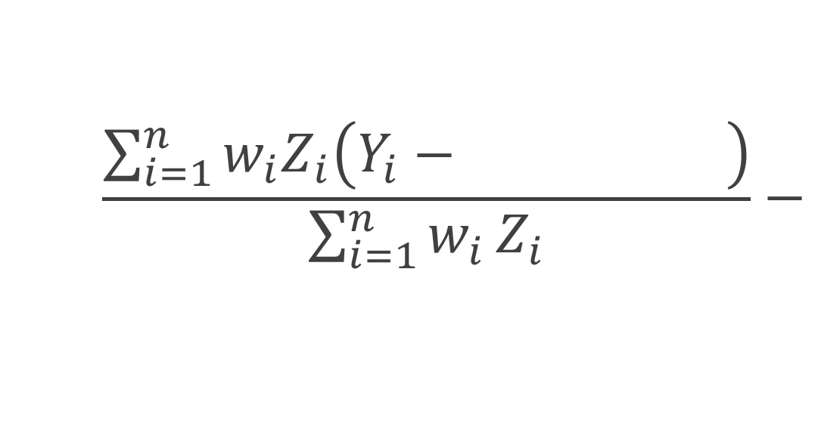
Doubly robust estimator
$${\hat{Δ}}_{DR, w}=\frac{\sum_{i=1}^{n}{w_{i}\left(m_{1}\left(X_{i},{\hat{α}}_{1}\right)−m_{0}\left(X_{i}, {\hat{α}}_{0}\right)\right)}}{\sum_{i=1}^{n}{w_{i}}}+$$
$$\frac{\sum_{i=1}^{n}{w_{i}Z_{i}\left(Y_{i}−m_{1}\left(X_{i}, {\hat{α}}_{1}\right)\right)}}{\sum_{i=1}^{n}{w_{i}}Z_{i}}−$$
$$\frac{\sum_{i=1}^{n}{w_{i}{(1−Z}_{i})\left(Y_{i}−m_{0}\left(X_{i}, {\hat{α}}_{0}\right)\right)}}{\sum_{i=1}^{n}{w_{i}}(1−Z_{i})}$$
Notes:
_click_ these ws are the weights we’ve just defined _click_
_click_ m1 is the predicted y value, calculated using the model built on the treated participants _click_
_click_ and m0 is the predicted y value, calculated using the model built on the participants assigned to the control group

Slide 37
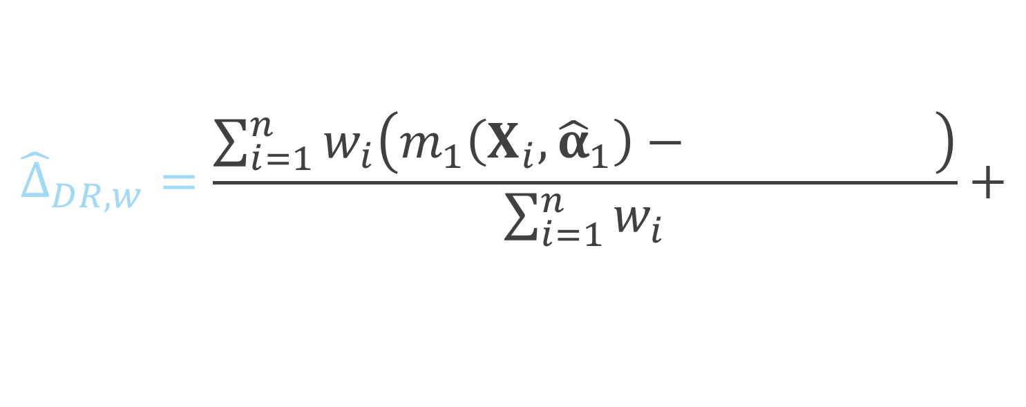
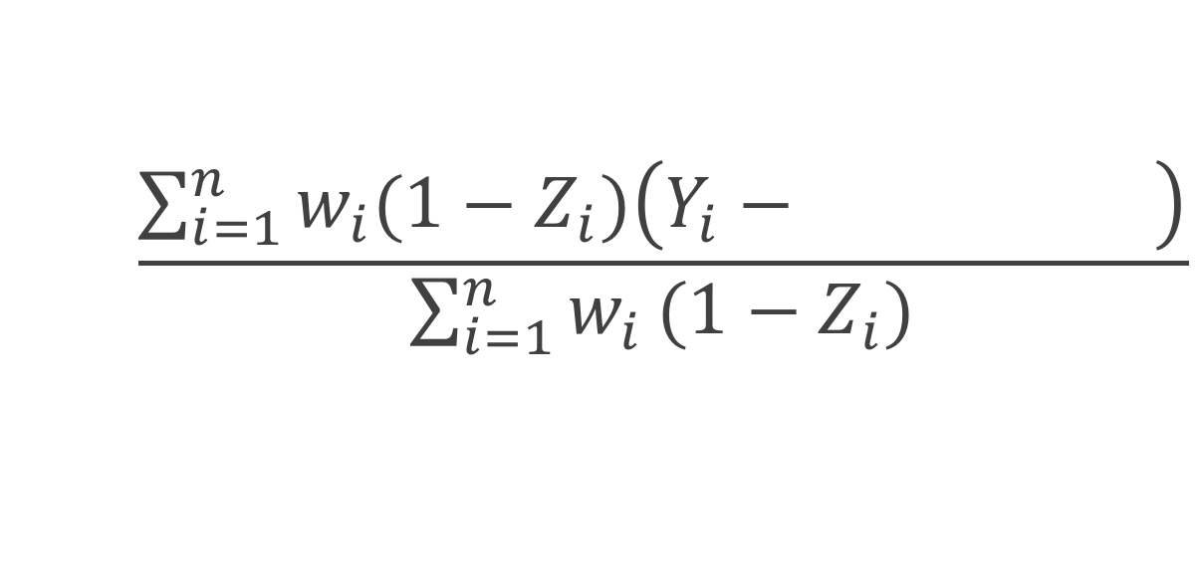
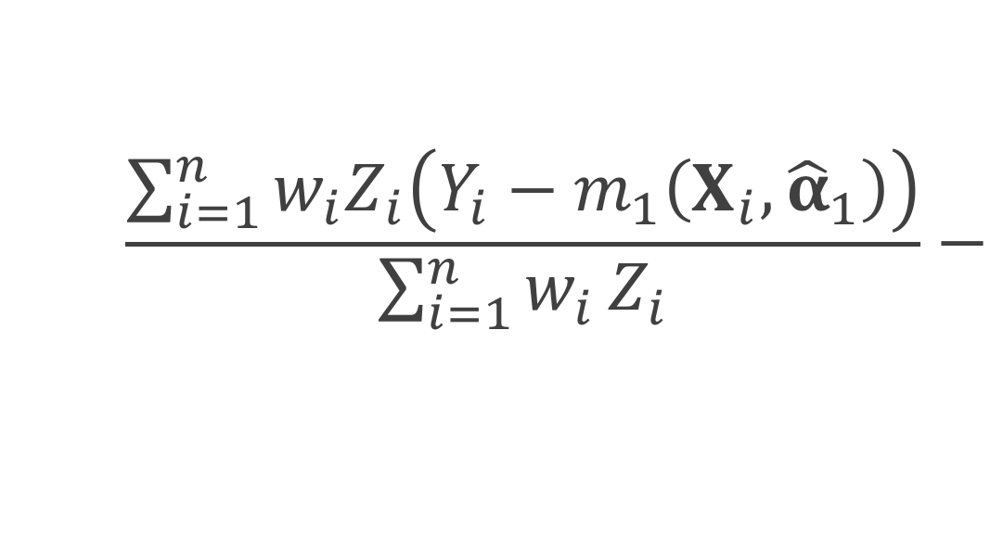
Doubly robust estimator
$${\hat{Δ}}_{DR, w}=\frac{\sum_{i=1}^{n}{w_{i}\left(m_{1}\left(X_{i},{\hat{α}}_{1}\right)−m_{0}\left(X_{i}, {\hat{α}}_{0}\right)\right)}}{\sum_{i=1}^{n}{w_{i}}}+$$
$$\frac{\sum_{i=1}^{n}{w_{i}Z_{i}\left(Y_{i}−m_{1}\left(X_{i}, {\hat{α}}_{1}\right)\right)}}{\sum_{i=1}^{n}{w_{i}}Z_{i}}−$$
$$\frac{\sum_{i=1}^{n}{w_{i}{(1−Z}_{i})\left(Y_{i}−m_{0}\left(X_{i}, {\hat{α}}_{0}\right)\right)}}{\sum_{i=1}^{n}{w_{i}}(1−Z_{i})}$$
Notes:
_click_ these ws are the weights we’ve just defined _click_
_click_ m1 is the predicted y value, calculated using the model built on the treated participants _click_
_click_ and m0 is the predicted y value, calculated using the model built on the participants assigned to the control group

Slide 38
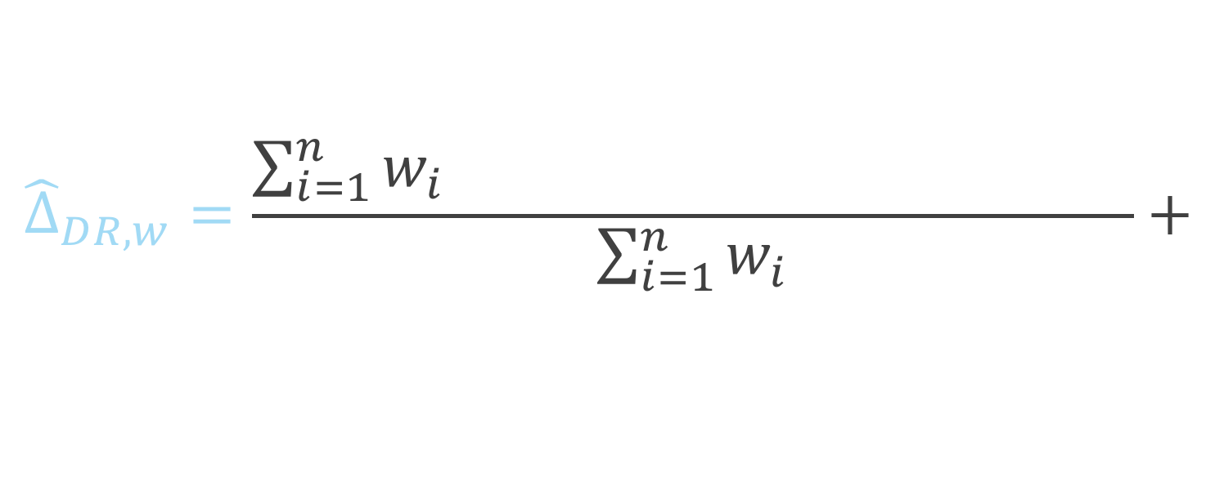
Doubly robust estimator
$${\hat{Δ}}_{DR, w}=\frac{\sum_{i=1}^{n}{w_{i}\left(m_{1}\left(X_{i},{\hat{α}}_{1}\right)−m_{0}\left(X_{i}, {\hat{α}}_{0}\right)\right)}}{\sum_{i=1}^{n}{w_{i}}}+$$
$$\frac{\sum_{i=1}^{n}{w_{i}Z_{i}\left(Y_{i}−m_{1}\left(X_{i}, {\hat{α}}_{1}\right)\right)}}{\sum_{i=1}^{n}{w_{i}}Z_{i}}−$$
$$\frac{\sum_{i=1}^{n}{w_{i}{(1−Z}_{i})\left(Y_{i}−m_{0}\left(X_{i}, {\hat{α}}_{0}\right)\right)}}{\sum_{i=1}^{n}{w_{i}}(1−Z_{i})}$$
Notes:
so here we have the difference between m1 and m0, so if the outcome model is correctly specified, this will be our quantity of interest

Slide 39
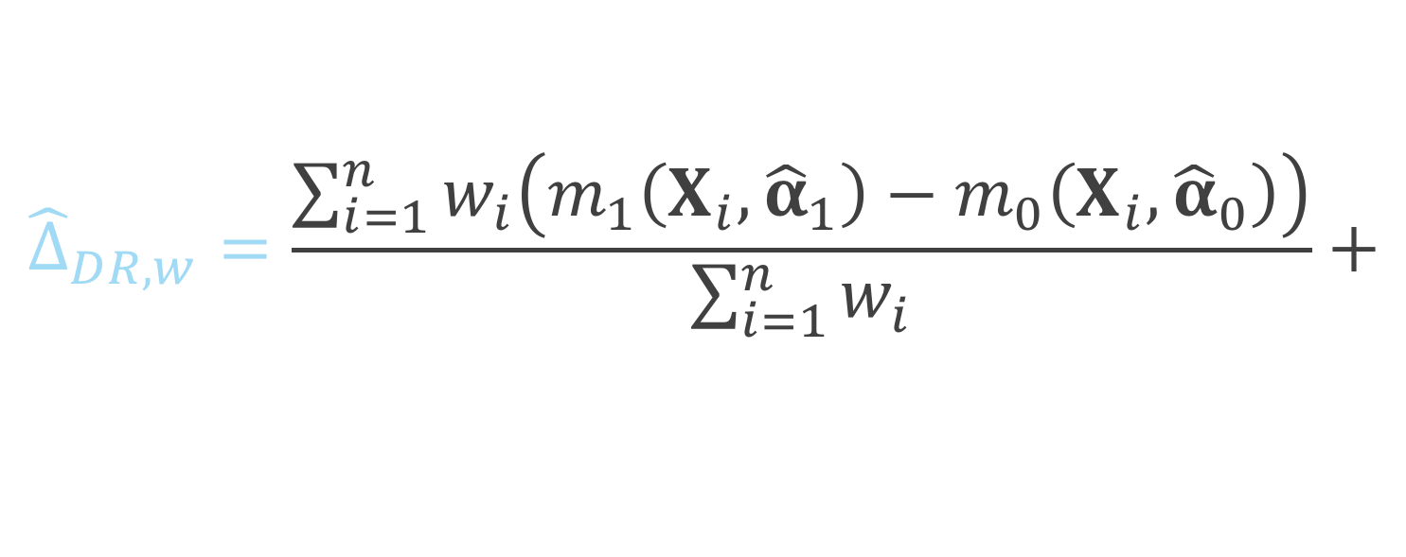
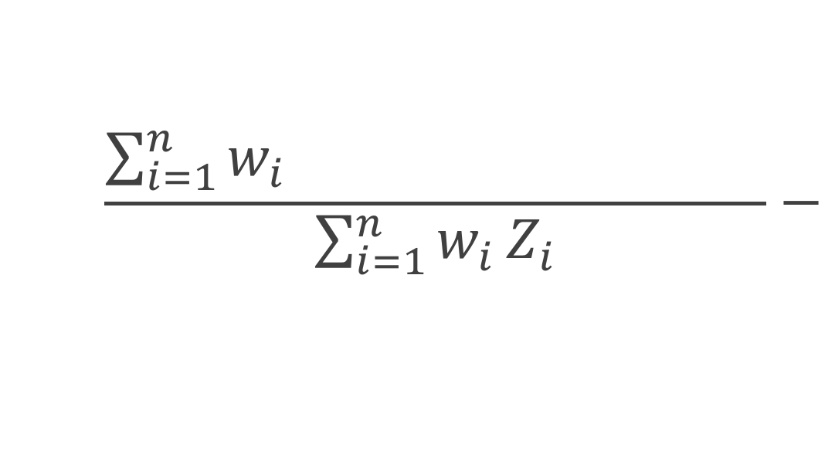
Doubly robust estimator
$${\hat{Δ}}_{DR, w}=\frac{\sum_{i=1}^{n}{w_{i}\left(m_{1}\left(X_{i},{\hat{α}}_{1}\right)−m_{0}\left(X_{i}, {\hat{α}}_{0}\right)\right)}}{\sum_{i=1}^{n}{w_{i}}}+$$
$$\frac{\sum_{i=1}^{n}{w_{i}Z_{i}\left(Y_{i}−m_{1}\left(X_{i}, {\hat{α}}_{1}\right)\right)}}{\sum_{i=1}^{n}{w_{i}}Z_{i}}−$$
$$\frac{\sum_{i=1}^{n}{w_{i}{(1−Z}_{i})\left(Y_{i}−m_{0}\left(X_{i}, {\hat{α}}_{0}\right)\right)}}{\sum_{i=1}^{n}{w_{i}}(1−Z_{i})}$$
Notes:
Here we have among the treated, the observed Y minus the predicted Y

Slide 40
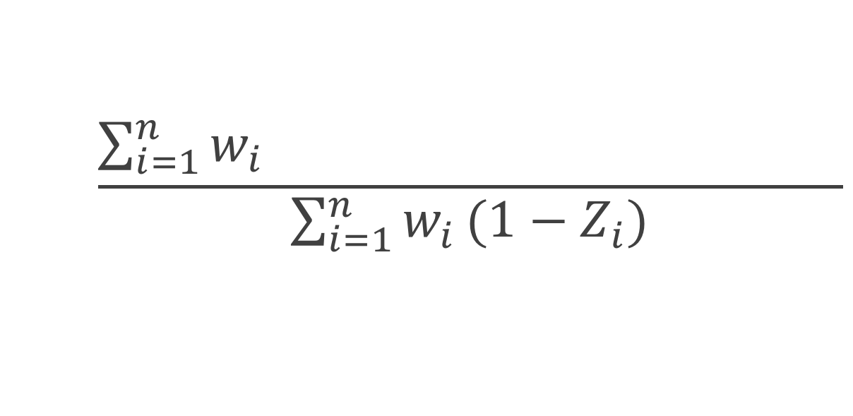
Doubly robust estimator
$${\hat{Δ}}_{DR, w}=\frac{\sum_{i=1}^{n}{w_{i}\left(m_{1}\left(X_{i},{\hat{α}}_{1}\right)−m_{0}\left(X_{i}, {\hat{α}}_{0}\right)\right)}}{\sum_{i=1}^{n}{w_{i}}}+$$
$$\frac{\sum_{i=1}^{n}{w_{i}Z_{i}\left(Y_{i}−m_{1}\left(X_{i}, {\hat{α}}_{1}\right)\right)}}{\sum_{i=1}^{n}{w_{i}}Z_{i}}−$$
$$\frac{\sum_{i=1}^{n}{w_{i}{(1−Z}_{i})\left(Y_{i}−m_{0}\left(X_{i}, {\hat{α}}_{0}\right)\right)}}{\sum_{i=1}^{n}{w_{i}}(1−Z_{i})}$$
Notes:
and similarly, among the controls we have the observed minus predicted y

Slide 41
Freedman & Berk Simulation

Slide 42
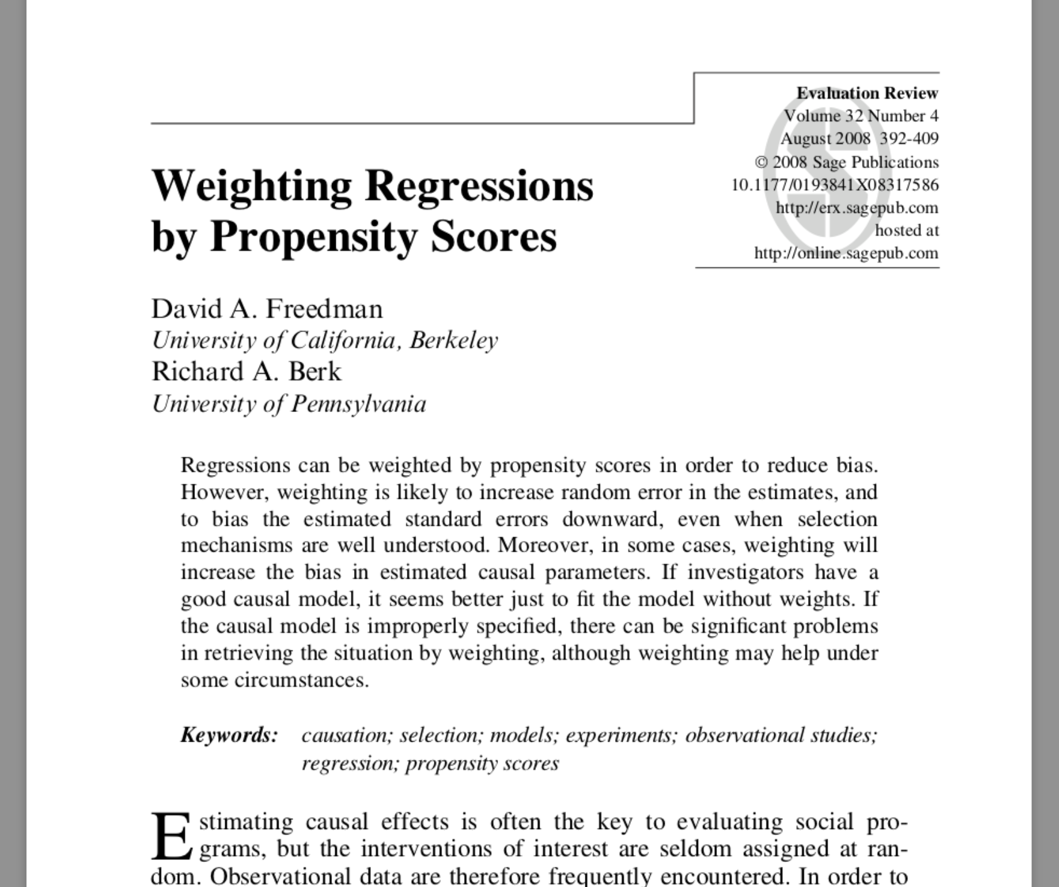

Slide 43
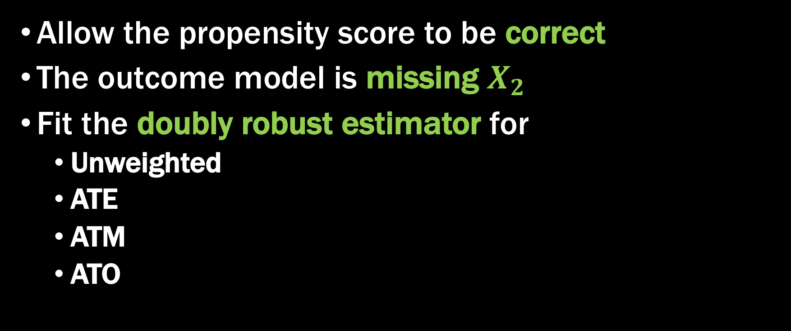
Fit a misspecified model
Allow the propensity score to be correct
The outcome model is missing $X_{2}$
Fit the doubly robust estimator for
Unweighted
ATE
ATM
ATO

Slide 44
Continuous outcome

Slide 45

Simulation
$$X \sim MVN\left(\left({0.5 \atop 1}\right), \left(\begin{matrix}2 & 1 \\ 1 & 1\end{matrix}\right)\right)$$
$$V \sim N \left(0, 1\right)$$
$$Z=\left\{\begin{aligned}1 0.5+0.25X_{1}+0.75X_{2}+V>0 \\ &0 o.w.\end{aligned}\right.$$
$$U \sim N(0, 1)$$
$$Y=1+Z+X_{1}+2X_{2}+U$$

Slide 49
Binary outcome

Slide 50

Simulation
$$X \sim MVN\left(\left({0.5 \atop 1}\right), \left(\begin{matrix}2 & 1 \\ 1 & 1\end{matrix}\right)\right)$$
$$V \sim logit \left(0, 1\right)$$
$$Z=\left\{\begin{aligned}1 0.5+0.25X_{1}+0.75X_{2}+V>0 \\ &0 o.w.\end{aligned}\right.$$
$$U \sim logit(0, 1)$$
$$Y=\left\{\begin{aligned}1 1+Z+X_{1}+2X_{2}+U>0 \\ &0 o.w.\end{aligned}\right.$$

Slide 55
Binary outcome (revised)

Slide 56

Simulation
$$X \sim MVN\left(\left({0.5 \atop 1}\right), \left(\begin{matrix}2 & 1 \\ 1 & 1\end{matrix}\right)\right)$$
$$V \sim N \left(0, 1\right)$$
$$Z=\left\{\begin{aligned}1 0.5+0.25X_{1}+0.75X_{2}+V>0 \\ &0 o.w.\end{aligned}\right.$$
$$U \sim logit(0, 1)$$
$$Y=\left\{\begin{aligned}1 1+3Z+X_{1}+2X_{2}+U>0 \\ &0 o.w.\end{aligned}\right.$$

Slide 57
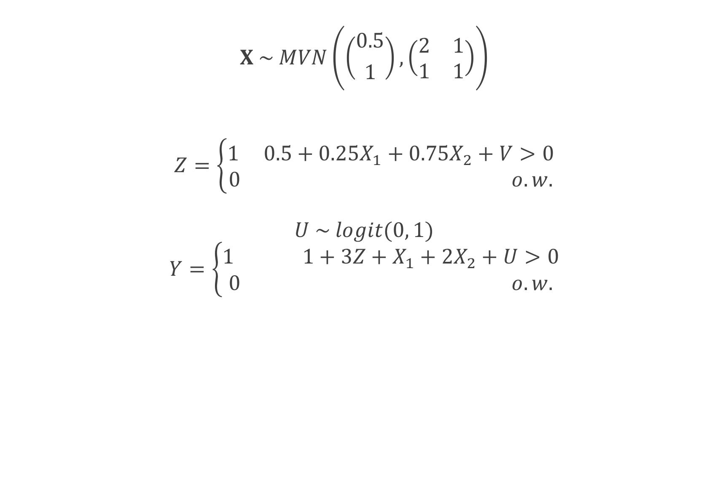
Simulation
$$X \sim MVN\left(\left({0.5 \atop 1}\right), \left(\begin{matrix}2 & 1 \\ 1 & 1\end{matrix}\right)\right)$$
$$V \sim N \left(0, 1\right)$$
$$Z=\left\{\begin{aligned}1 0.5+0.25X_{1}+0.75X_{2}+V>0 \\ &0 o.w.\end{aligned}\right.$$
$$U \sim logit(0, 1)$$
$$Y=\left\{\begin{aligned}1 1+3Z+X_{1}+2X_{2}+U>0 \\ &0 o.w.\end{aligned}\right.$$

Slide 58
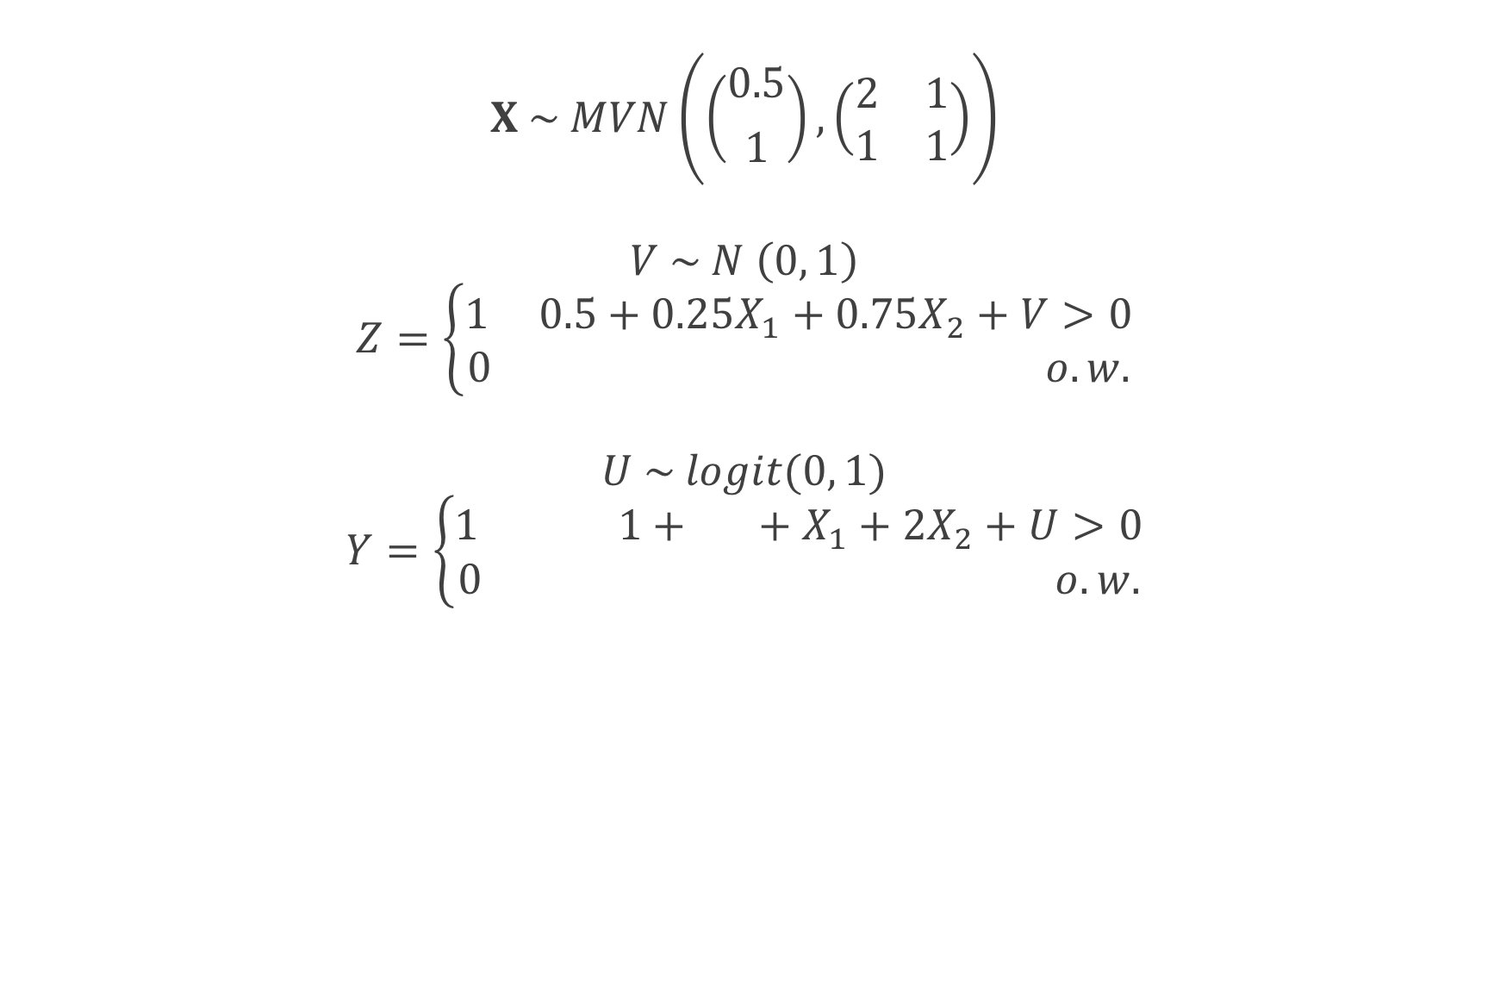
Simulation
$$X \sim MVN\left(\left({0.5 \atop 1}\right), \left(\begin{matrix}2 & 1 \\ 1 & 1\end{matrix}\right)\right)$$
$$V \sim N \left(0, 1\right)$$
$$Z=\left\{\begin{aligned}1 0.5+0.25X_{1}+0.75X_{2}+V>0 \\ &0 o.w.\end{aligned}\right.$$
$$U \sim logit(0, 1)$$
$$Y=\left\{\begin{aligned}1 1+3Z+X_{1}+2X_{2}+U>0 \\ &0 o.w.\end{aligned}\right.$$

Slide 63
Standard errors

Slide 66
Recap
Replicated the finite-sample bias seen by Freedman and Berk using the ATE weights
ATM and ATO weights had improved finite-sample properties
The variance for the ATO and ATM is preferable to that of the ATE

Slide 67
Q&A

Slide 68
Doubly robust and large sample variance estimator for overlap weights

Slide 69

ATO estimator
$$\frac{\sum_{i=1}^{n}{\left(1−e\left(X_{i}, \hat{β}\right)\right)Z_{i}Y_{i}}}{\sum_{i=1}^{n}{\left(1−e\left(X_{i}, \hat{β}\right)\right)Z_{i}}}−\frac{\sum_{i=1}^{n}{e\left(X_{i}, \hat{β}\right){(1−Z}_{i})Y_{i}}}{\sum_{i=1}^{n}{e\left(X_{i}, \hat{β}\right)(1−Z_{i})}}$$

Slide 70
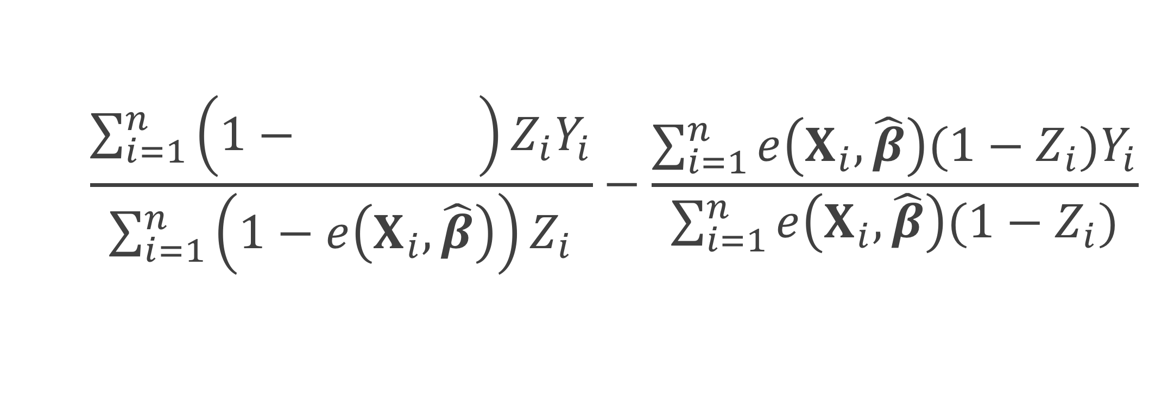
ATO estimator
$$\frac{\sum_{i=1}^{n}{\left(1−e\left(X_{i}, \hat{β}\right)\right)Z_{i}Y_{i}}}{\sum_{i=1}^{n}{\left(1−e\left(X_{i}, \hat{β}\right)\right)Z_{i}}}−\frac{\sum_{i=1}^{n}{e\left(X_{i}, \hat{β}\right){(1−Z}_{i})Y_{i}}}{\sum_{i=1}^{n}{e\left(X_{i}, \hat{β}\right)(1−Z_{i})}}$$
Notes:
Here I represent the fitted propensity score by e(Xi, beta hat) – this is often estimated by fitting a propensity score model using a logistic regression. Xi are the covariate values for participant I, beta hat are the betas obtained from the propensity score model.

Slide 71
ATO estimator
$$\frac{\sum_{i=1}^{n}{\left(1−e\left(X_{i}, \hat{β}\right)\right)Z_{i}Y_{i}}}{\sum_{i=1}^{n}{\left(1−e\left(X_{i}, \hat{β}\right)\right)Z_{i}}}−\frac{\sum_{i=1}^{n}{e\left(X_{i}, \hat{β}\right){(1−Z}_{i})Y_{i}}}{\sum_{i=1}^{n}{e\left(X_{i}, \hat{β}\right)(1−Z_{i})}}$$

Slide 72
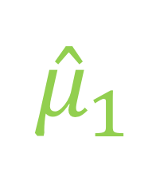
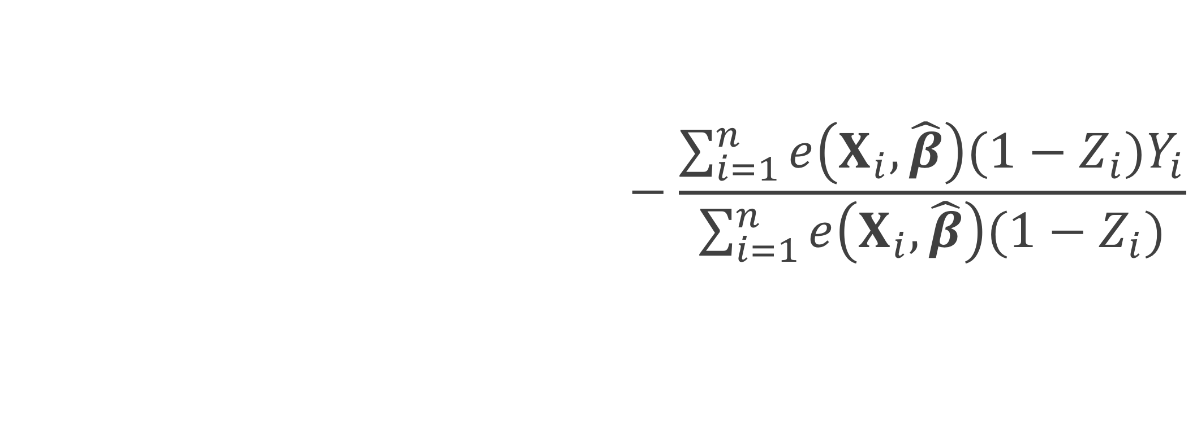
ATO estimator
$$\frac{\sum_{i=1}^{n}{\left(1−e\left(X_{i}, \hat{β}\right)\right)Z_{i}Y_{i}}}{\sum_{i=1}^{n}{\left(1−e\left(X_{i}, \hat{β}\right)\right)Z_{i}}}−\frac{\sum_{i=1}^{n}{e\left(X_{i}, \hat{β}\right){(1−Z}_{i})Y_{i}}}{\sum_{i=1}^{n}{e\left(X_{i}, \hat{β}\right)(1−Z_{i})}}$$
$${\hat{μ}}_{1}$$

Slide 73

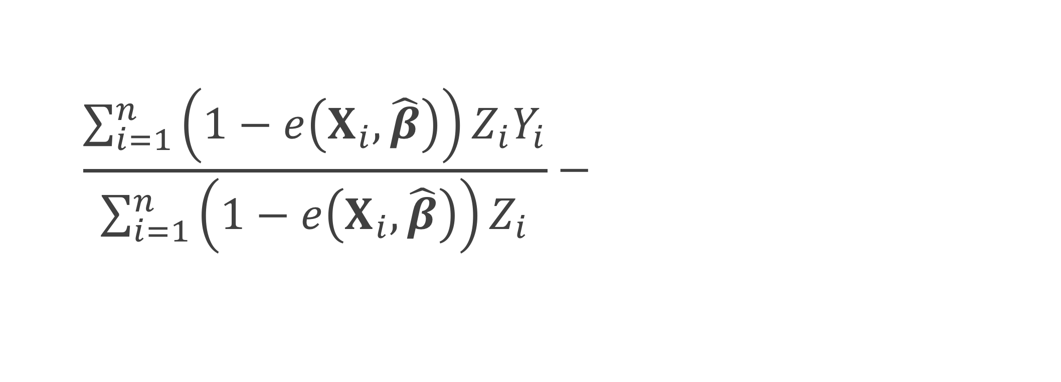

ATO estimator
$$\frac{\sum_{i=1}^{n}{\left(1−e\left(X_{i}, \hat{β}\right)\right)Z_{i}Y_{i}}}{\sum_{i=1}^{n}{\left(1−e\left(X_{i}, \hat{β}\right)\right)Z_{i}}}−\frac{\sum_{i=1}^{n}{e\left(X_{i}, \hat{β}\right){(1−Z}_{i})Y_{i}}}{\sum_{i=1}^{n}{e\left(X_{i}, \hat{β}\right)(1−Z_{i})}}$$
$${\hat{μ}}_{1}$$
$${\hat{μ}}_{0}$$

Slide 74
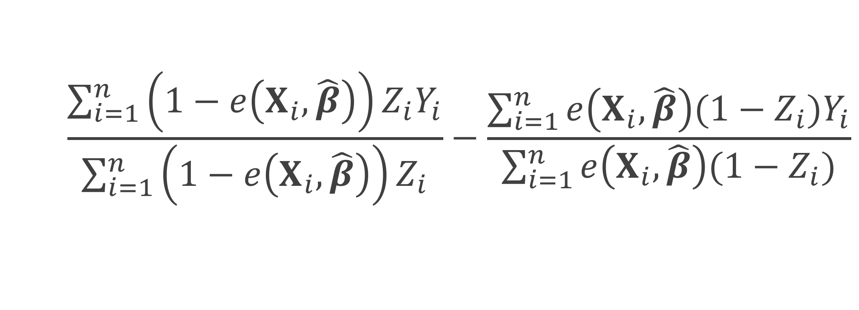

ATO estimator
$$\frac{\sum_{i=1}^{n}{\left(1−e\left(X_{i}, \hat{β}\right)\right)Z_{i}Y_{i}}}{\sum_{i=1}^{n}{\left(1−e\left(X_{i}, \hat{β}\right)\right)Z_{i}}}−\frac{\sum_{i=1}^{n}{e\left(X_{i}, \hat{β}\right){(1−Z}_{i})Y_{i}}}{\sum_{i=1}^{n}{e\left(X_{i}, \hat{β}\right)(1−Z_{i})}}$$
$${\hat{μ}}_{1}$$
$$−$$
$${\hat{μ}}_{0}$$

Slide 75
How to
Plug in
Fit a weighted generalized linear model Y ~ Z

Slide 76
How to
Plug in
Fit a weighted generalized linear model Y ~ Z
But what about the variance?
Pull from the GLM?
Robust standard errors? (sandwich estimator)
Notes:
These robust standard errors do no take into account the fact that you fit a propensity score prior to fitting your weighted GLM

Slide 77
Williamson 2013
“
…ignoring the estimation of the propensity score in the calculation of the variance leads to the erroneous conclusion that the IPTW treatment effect estimator has the same variance as an unadjusted estimator; thus, it is important to use a variance estimator that correctly takes into account the estimation of the propensity score.
”

Slide 78


ATO estimator
ATO weight
$$u\left(θ\right)=\left(\begin{matrix}\left(Y−μ_{1}\right)Z\left(1−e\left(X, β\right)\right) \\ \left(Y−μ_{0}\right)\left(1−Z\right)e\left(X, β\right) \\ X\left(Z−e\left(X, β\right)\right)\end{matrix}\right)$$
$$θ={\left(μ_{1}, μ_{0},β^{T}\right)}^{T}$$

Slide 79

Sandwich estimator
$$var\left(θ\right)=A^{−1}BA^{−T}$$

Slide 80

Sandwich estimator
$$var\left(θ\right)=A^{−1}BA^{−T}$$
$$A=−E\left[\frac{∂u\left(θ\right)}{∂θ}\right]$$

Slide 81


$$θ={\left(μ_{1}, μ_{0},β^{T}\right)}^{T}$$
$$u\left(θ\right)=\left(\begin{matrix}\left(Y−μ_{1}\right)Z\left(1−e\left(X, β\right)\right) \\ \left(Y−μ_{0}\right)\left(1−Z\right)e\left(X, β\right) \\ X\left(Z−e\left(X, β\right)\right)\end{matrix}\right)$$
$$A=−E\left[\frac{∂u\left(θ\right)}{∂θ}\right]$$

Slide 82
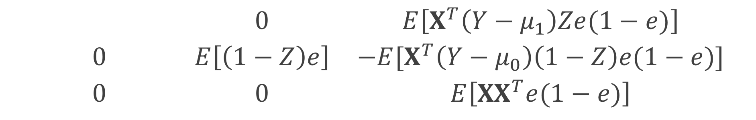
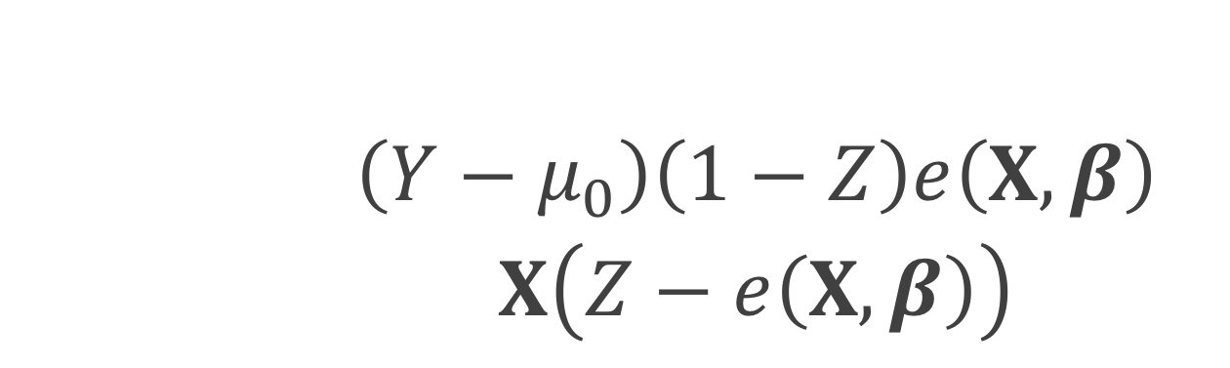
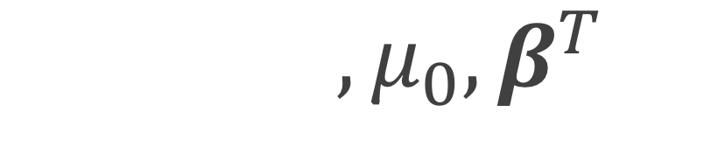
$$θ={\left(μ_{1}, μ_{0},β^{T}\right)}^{T}$$
$$u\left(θ\right)=\left(\begin{matrix}\left(Y−μ_{1}\right)Z\left(1−e\left(X, β\right)\right) \\ \left(Y−μ_{0}\right)\left(1−Z\right)e\left(X, β\right) \\ X\left(Z−e\left(X, β\right)\right)\end{matrix}\right)$$
$$\left(\begin{matrix}E\left[Z(1−e)\right] & 0 & E\left[X^{T}\left(Y−μ_{1}\right)Ze(1−e)\right] \\ 0 & E\left[\left(1−Z\right)e\right] & −E[X^{T}\left(Y−μ_{0}\right)\left(1−Z\right)e(1−e)] \\ 0 & 0 & E\left[{XX}^{T}e(1−e)\right]\end{matrix}\right)$$

Slide 83
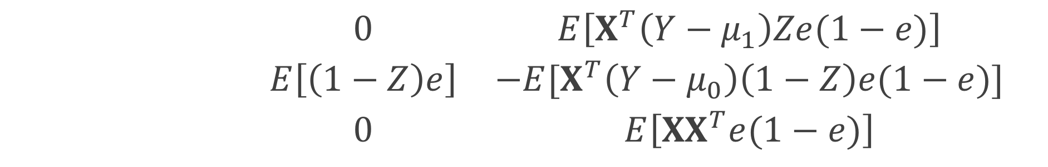
$$θ={\left(μ_{1}, μ_{0},β^{T}\right)}^{T}$$
$$u\left(θ\right)=\left(\begin{matrix}\left(Y−μ_{1}\right)Z\left(1−e\left(X, β\right)\right) \\ \left(Y−μ_{0}\right)\left(1−Z\right)e\left(X, β\right) \\ X\left(Z−e\left(X, β\right)\right)\end{matrix}\right)$$
$$\left(\begin{matrix}E\left[Z(1−e)\right] & 0 & E\left[X^{T}\left(Y−μ_{1}\right)Ze(1−e)\right] \\ 0 & E\left[\left(1−Z\right)e\right] & −E[X^{T}\left(Y−μ_{0}\right)\left(1−Z\right)e(1−e)] \\ 0 & 0 & E\left[{XX}^{T}e(1−e)\right]\end{matrix}\right)$$

Slide 84
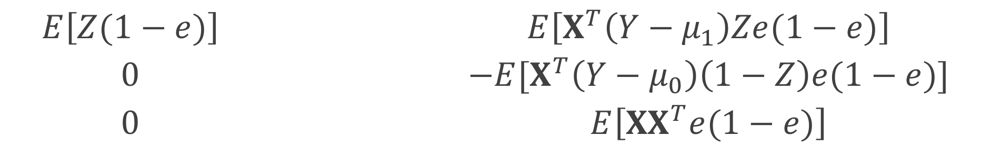
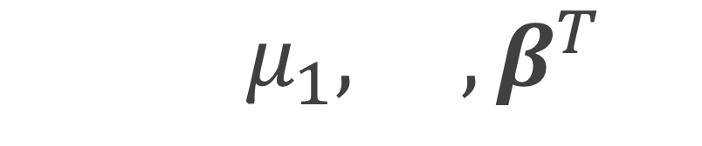
$$θ={\left(μ_{1}, μ_{0},β^{T}\right)}^{T}$$
$$u\left(θ\right)=\left(\begin{matrix}\left(Y−μ_{1}\right)Z\left(1−e\left(X, β\right)\right) \\ \left(Y−μ_{0}\right)\left(1−Z\right)e\left(X, β\right) \\ X\left(Z−e\left(X, β\right)\right)\end{matrix}\right)$$
$$\left(\begin{matrix}E\left[Z(1−e)\right] & 0 & E\left[X^{T}\left(Y−μ_{1}\right)Ze(1−e)\right] \\ 0 & E\left[\left(1−Z\right)e\right] & −E[X^{T}\left(Y−μ_{0}\right)\left(1−Z\right)e(1−e)] \\ 0 & 0 & E\left[{XX}^{T}e(1−e)\right]\end{matrix}\right)$$

Slide 85
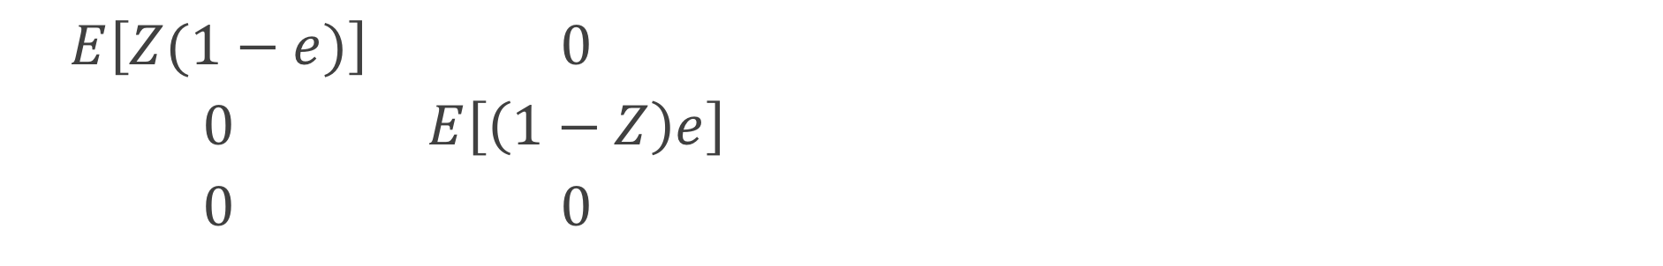
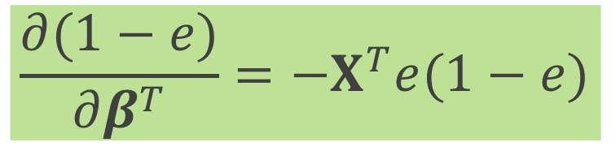
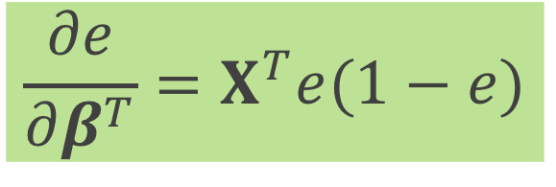

$$θ={\left(μ_{1}, μ_{0},β^{T}\right)}^{T}$$
$$u\left(θ\right)=\left(\begin{matrix}\left(Y−μ_{1}\right)Z\left(1−e\left(X, β\right)\right) \\ \left(Y−μ_{0}\right)\left(1−Z\right)e\left(X, β\right) \\ X\left(Z−e\left(X, β\right)\right)\end{matrix}\right)$$
$$\frac{∂e}{∂β^{T}}=X^{T}e(1−e)$$
$$\left(\begin{matrix}E\left[Z(1−e)\right] & 0 & E\left[X^{T}\left(Y−μ_{1}\right)Ze(1−e)\right] \\ 0 & E\left[\left(1−Z\right)e\right] & −E[X^{T}\left(Y−μ_{0}\right)\left(1−Z\right)e(1−e)] \\ 0 & 0 & E\left[{XX}^{T}e(1−e)\right]\end{matrix}\right)$$
$$\frac{∂(1−e)}{∂β^{T}}={−X}^{T}e(1−e)$$

Slide 86

Sandwich estimator
$$var\left(θ\right)=A^{−1}BA^{−T}$$
$B=E\left[u\left(θ\right)u{\left(θ\right)}^{T}\right]$

Slide 87



$B=E\left[u\left(θ\right)u{\left(θ\right)}^{T}\right]$
$$B=E\left[\left(\begin{matrix}\left(Y−μ_{1}\right)Z\left(1−e\left(X, β\right)\right) \\ \left(Y−μ_{0}\right)\left(1−Z\right)e\left(X, β\right) \\ X\left(Z−e\left(X, β\right)\right)\end{matrix}\right)× \right.$$
$$\left.{\left(\begin{matrix}\left(Y−μ_{1}\right)Z\left(1−e\left(X, β\right)\right) \\ \left(Y−μ_{0}\right)\left(1−Z\right)e\left(X, β\right) \\ X\left(Z−e\left(X, β\right)\right)\end{matrix}\right)}^{T}\right]$$

Slide 88

Sandwich estimator
$$\hat{var}\left(\hat{θ}\right)=\frac{1}{n}{{\hat{A}}_{n}}^{−1}{\hat{B}}_{n}{{\hat{A}}_{n}}^{−T}$$
Notes:
We can replace the expectations by the sample average to get an approximate large sample variance

Slide 89

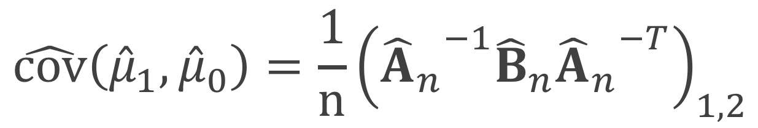
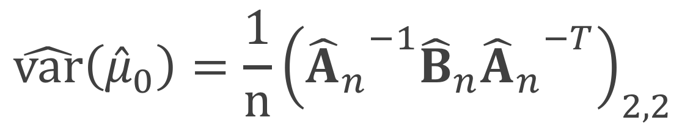
Sandwich estimator
$$\hat{var}\left({\hat{μ}}_{1}\right)=\frac{1}{n}{\left({{\hat{A}}_{n}}^{−1}{\hat{B}}_{n}{{\hat{A}}_{n}}^{−T}\right)}_{1,1}$$
$$\hat{var}\left({\hat{μ}}_{0}\right)=\frac{1}{n}{\left({{\hat{A}}_{n}}^{−1}{\hat{B}}_{n}{{\hat{A}}_{n}}^{−T}\right)}_{2,2}$$
$$\hat{cov}\left({{\hat{μ}}_{1},\hat{μ}}_{0}\right)=\frac{1}{n}{\left({{\hat{A}}_{n}}^{−1}{\hat{B}}_{n}{{\hat{A}}_{n}}^{−T}\right)}_{1,2}$$

Slide 90
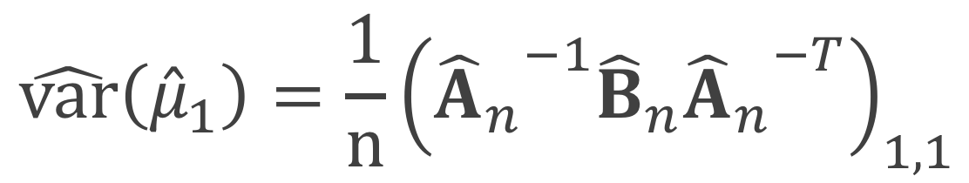

Sandwich estimator
$$\hat{var}\left({\hat{μ}}_{1}\right)=\frac{1}{n}{\left({{\hat{A}}_{n}}^{−1}{\hat{B}}_{n}{{\hat{A}}_{n}}^{−T}\right)}_{1,1}$$
$$\hat{var}\left({\hat{μ}}_{0}\right)=\frac{1}{n}{\left({{\hat{A}}_{n}}^{−1}{\hat{B}}_{n}{{\hat{A}}_{n}}^{−T}\right)}_{2,2}$$
$$\hat{cov}\left({{\hat{μ}}_{1},\hat{μ}}_{0}\right)=\frac{1}{n}{\left({{\hat{A}}_{n}}^{−1}{\hat{B}}_{n}{{\hat{A}}_{n}}^{−T}\right)}_{1,2}$$

Slide 91

Sandwich estimator
$$\hat{var}\left({\hat{μ}}_{1}\right)=\frac{1}{n}{\left({{\hat{A}}_{n}}^{−1}{\hat{B}}_{n}{{\hat{A}}_{n}}^{−T}\right)}_{1,1}$$
$$\hat{var}\left({\hat{μ}}_{0}\right)=\frac{1}{n}{\left({{\hat{A}}_{n}}^{−1}{\hat{B}}_{n}{{\hat{A}}_{n}}^{−T}\right)}_{2,2}$$
$$\hat{cov}\left({{\hat{μ}}_{1},\hat{μ}}_{0}\right)=\frac{1}{n}{\left({{\hat{A}}_{n}}^{−1}{\hat{B}}_{n}{{\hat{A}}_{n}}^{−T}\right)}_{1,2}$$

Slide 92
Sandwich estimator
$$\hat{var}\left({\hat{μ}}_{1}\right)=\frac{1}{n}{\left({{\hat{A}}_{n}}^{−1}{\hat{B}}_{n}{{\hat{A}}_{n}}^{−T}\right)}_{1,1}$$
$$\hat{var}\left({\hat{μ}}_{0}\right)=\frac{1}{n}{\left({{\hat{A}}_{n}}^{−1}{\hat{B}}_{n}{{\hat{A}}_{n}}^{−T}\right)}_{2,2}$$
$$\hat{cov}\left({{\hat{μ}}_{1},\hat{μ}}_{0}\right)=\frac{1}{n}{\left({{\hat{A}}_{n}}^{−1}{\hat{B}}_{n}{{\hat{A}}_{n}}^{−T}\right)}_{1,2}$$

Slide 93
What if we want to also adjust the outcome model?

Slide 94
How to
Fit a weighted generalized linear model Y ~ Z + X
Doubly robust estimator
Notes:
Fit a single weighted generalized linear model, with the Xs included – this is commonly what I have seen done in the literature – under the continuous case, using a GLM with a identity link, this is essentially a doubly robust estimator
Use a doubly robust estimator where we fit two models, one among the treated and one among the controls and combine them using the weights

Slide 95
How to
Fit a weighted generalized linear model Y ~ Z + X
Doubly robust estimator
But what about the variance?
Pull from the GLM?
Robust standard errors? (sandwich estimator)
Notes:
But what about the variance? Again if we are fitting a single model, we can pull the variances directly from the GLM or we can use robust standard errors, however the robust standard errors from a GLM won’t incorporate the fact that the propensity scores are not fixed. Alternatively, we can use the doubly robust estimator and fit an updated large-sample variance that incorporates the propensity score model

Slide 96

ATO DR estimator
$${\hat{Δ}}_{DR, ATO}={\hat{δ}}_{1}+{\hat{δ}}_{2}−{\hat{δ}}_{3}$$
Notes:
We can write the doubly robust estimator for the ATO in 3 equations, delta 1, delta2 and delta 3

Slide 97
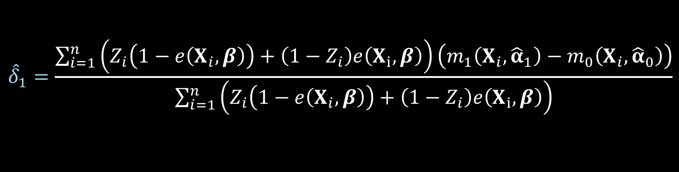
ATO DR estimator
$${\hat{Δ}}_{DR, ATO}={\hat{δ}}_{1}+{\hat{δ}}_{2}−{\hat{δ}}_{3}$$
$${\hat{δ}}_{1}=\frac{\sum_{i=1}^{n}{\left(Z_{i}\left(1−e\left(X_{i},β\right)\right)+\left(1−Z_{i}\right)e\left(X_{i}, β\right)\right)\left(m_{1}\left(X_{i},{\hat{α}}_{1}\right)−m_{0}\left(X_{i}, {\hat{α}}_{0}\right)\right)}}{\sum_{i=1}^{n}{\left(Z_{i}\left(1−e\left(X_{i},β\right)\right)+\left(1−Z_{i}\right)e\left(X_{i}, β\right)\right)}}$$
Notes:
Here is delta 1

Slide 98
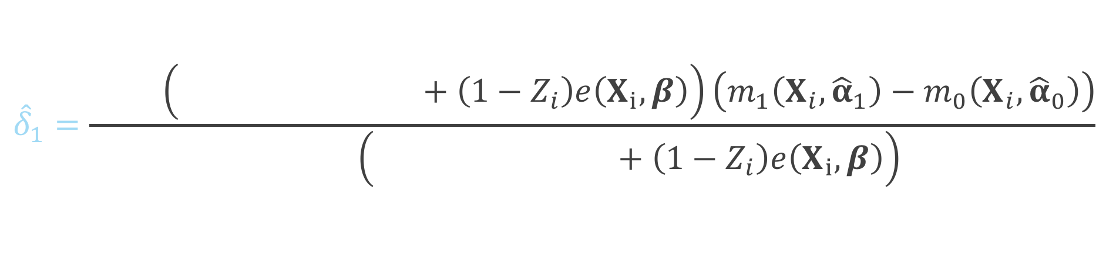
ATO DR estimator
$${\hat{Δ}}_{DR, ATO}={\hat{δ}}_{1}+{\hat{δ}}_{2}−{\hat{δ}}_{3}$$
$${\hat{δ}}_{1}=\frac{\sum_{i=1}^{n}{\left(Z_{i}\left(1−e\left(X_{i},β\right)\right)+\left(1−Z_{i}\right)e\left(X_{i}, β\right)\right)\left(m_{1}\left(X_{i},{\hat{α}}_{1}\right)−m_{0}\left(X_{i}, {\hat{α}}_{0}\right)\right)}}{\sum_{i=1}^{n}{\left(Z_{i}\left(1−e\left(X_{i},β\right)\right)+\left(1−Z_{i}\right)e\left(X_{i}, β\right)\right)}}$$
Notes:
This will be weighted by 1 minus the propensity score for the treated

Slide 99
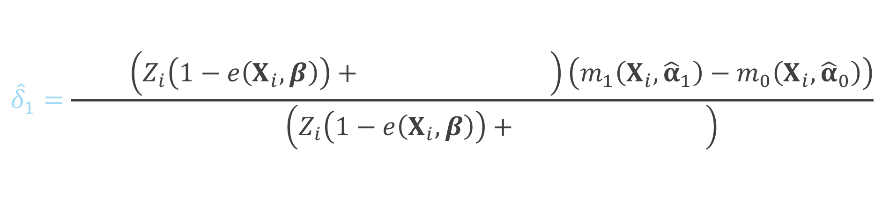
ATO DR estimator
$${\hat{Δ}}_{DR, ATO}={\hat{δ}}_{1}+{\hat{δ}}_{2}−{\hat{δ}}_{3}$$
$${\hat{δ}}_{1}=\frac{\sum_{i=1}^{n}{\left(Z_{i}\left(1−e\left(X_{i},β\right)\right)+\left(1−Z_{i}\right)e\left(X_{i}, β\right)\right)\left(m_{1}\left(X_{i},{\hat{α}}_{1}\right)−m_{0}\left(X_{i}, {\hat{α}}_{0}\right)\right)}}{\sum_{i=1}^{n}{\left(Z_{i}\left(1−e\left(X_{i},β\right)\right)+\left(1−Z_{i}\right)e\left(X_{i}, β\right)\right)}}$$
Notes:
And the propensity score for the controls

Slide 100
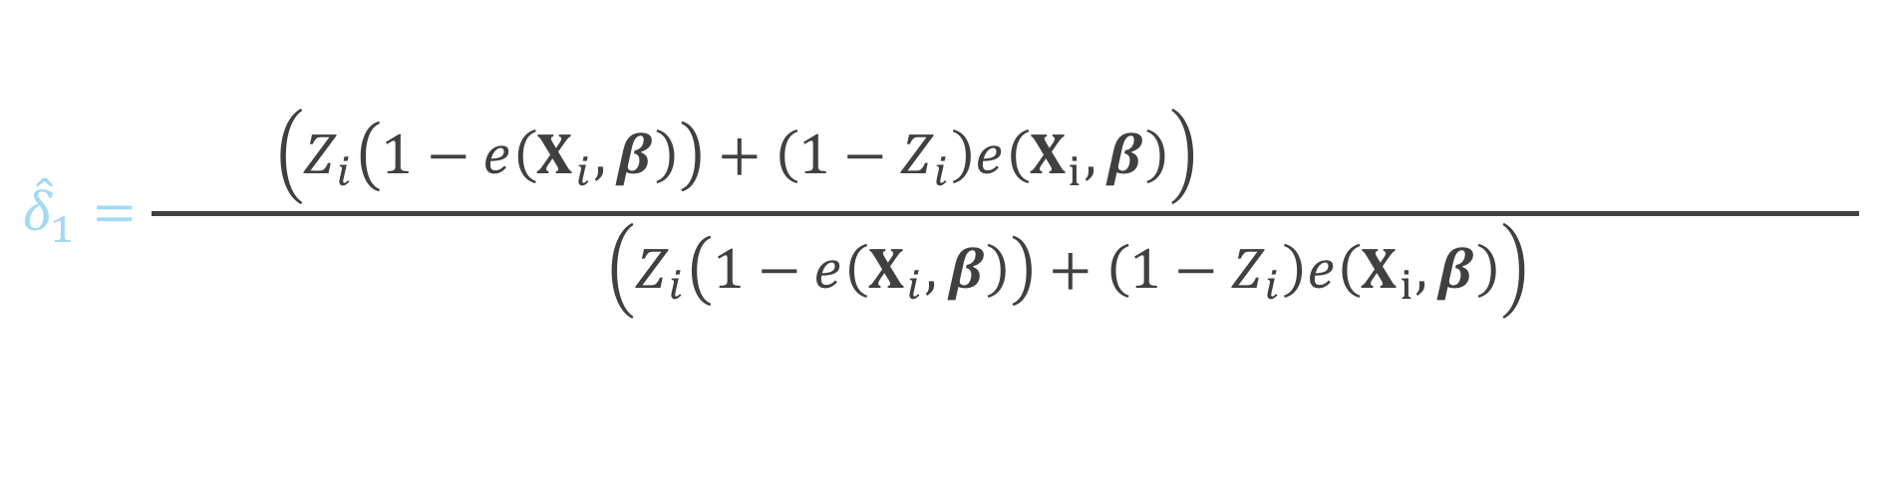
ATO DR estimator
$${\hat{Δ}}_{DR, ATO}={\hat{δ}}_{1}+{\hat{δ}}_{2}−{\hat{δ}}_{3}$$
$${\hat{δ}}_{1}=\frac{\sum_{i=1}^{n}{\left(Z_{i}\left(1−e\left(X_{i},β\right)\right)+\left(1−Z_{i}\right)e\left(X_{i}, β\right)\right)\left(m_{1}\left(X_{i},{\hat{α}}_{1}\right)−m_{0}\left(X_{i}, {\hat{α}}_{0}\right)\right)}}{\sum_{i=1}^{n}{\left(Z_{i}\left(1−e\left(X_{i},β\right)\right)+\left(1−Z_{i}\right)e\left(X_{i}, β\right)\right)}}$$
Notes:
Here is the difference between the Y predicted among the treated and the Y predicted among the controls

Slide 101
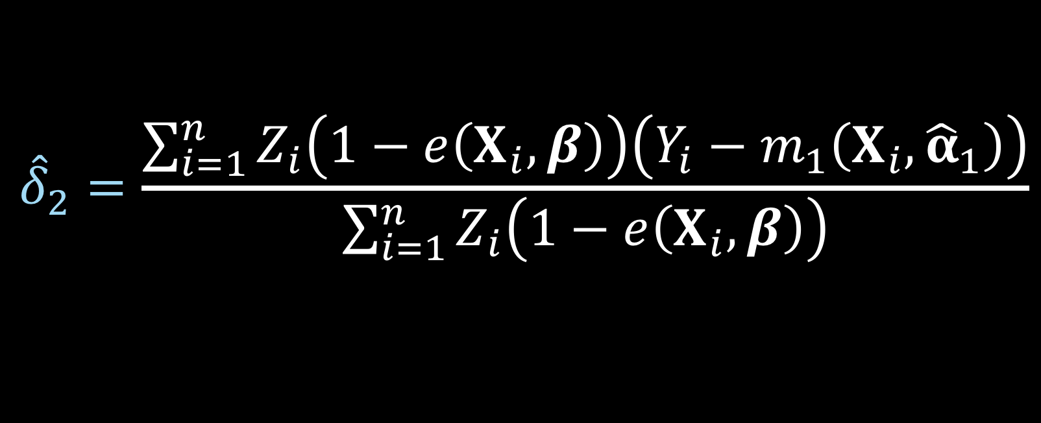
ATO DR estimator
$${\hat{Δ}}_{DR, ATO}={\hat{δ}}_{1}+{\hat{δ}}_{2}−{\hat{δ}}_{3}$$
$${\hat{δ}}_{2}=\frac{\sum_{i=1}^{n}{Z_{i}\left(1−e\left(X_{i},β\right)\right)\left(Y_{i}−m_{1}\left(X_{i},{\hat{α}}_{1}\right)\right)}}{\sum_{i=1}^{n}{Z_{i}\left(1−e\left(X_{i},β\right)\right)}}$$
Notes:
Here is delta 2

Slide 102
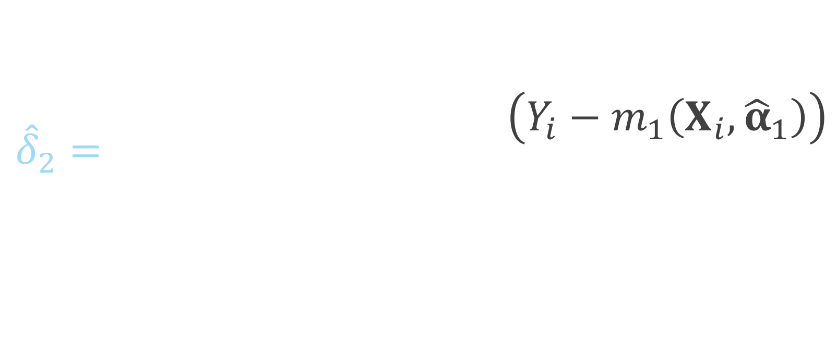
ATO DR estimator
$${\hat{Δ}}_{DR, ATO}={\hat{δ}}_{1}+{\hat{δ}}_{2}−{\hat{δ}}_{3}$$
$${\hat{δ}}_{2}=\frac{\sum_{i=1}^{n}{Z_{i}\left(1−e\left(X_{i},β\right)\right)\left(Y_{i}−m_{1}\left(X_{i},{\hat{α}}_{1}\right)\right)}}{\sum_{i=1}^{n}{Z_{i}\left(1−e\left(X_{i},β\right)\right)}}$$
Notes:
Notice this is just among the treated, so if the subject i is in the control group, this will be zero, since Zi will be 0

Slide 103
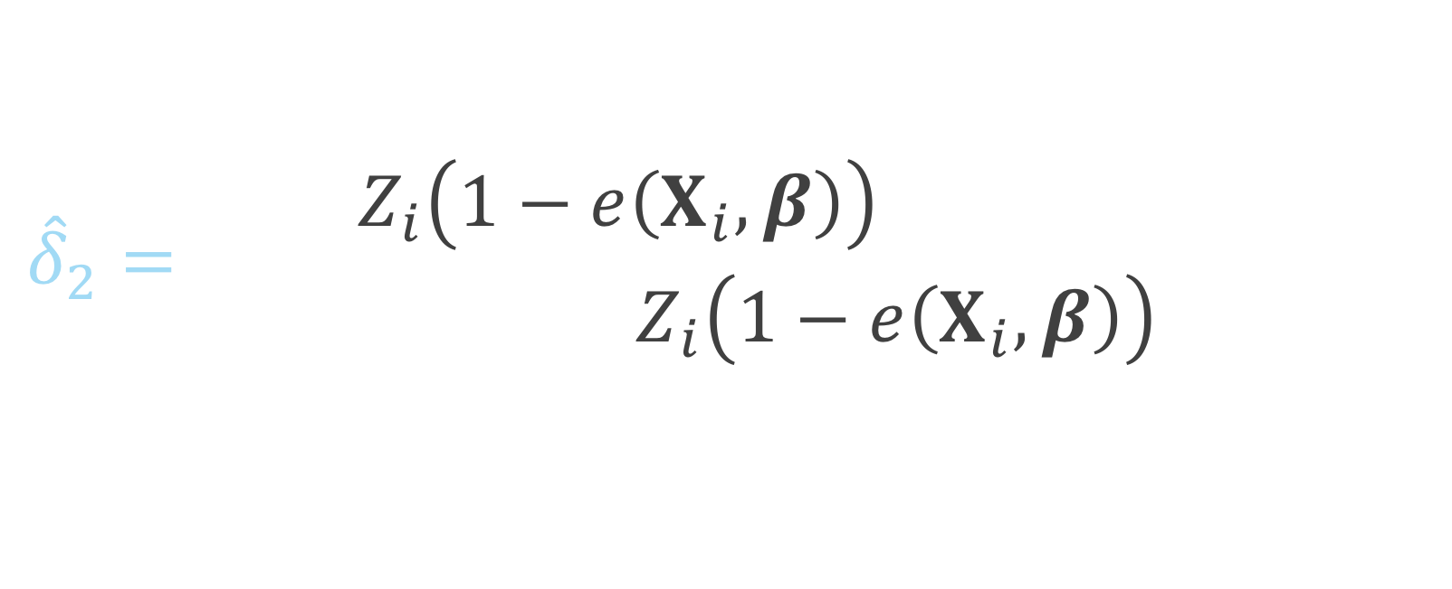
ATO DR estimator
$${\hat{Δ}}_{DR, ATO}={\hat{δ}}_{1}+{\hat{δ}}_{2}−{\hat{δ}}_{3}$$
$${\hat{δ}}_{2}=\frac{\sum_{i=1}^{n}{Z_{i}\left(1−e\left(X_{i},β\right)\right)\left(Y_{i}−m_{1}\left(X_{i},{\hat{α}}_{1}\right)\right)}}{\sum_{i=1}^{n}{Z_{i}\left(1−e\left(X_{i},β\right)\right)}}$$
Notes:
This piece is essentially the residual between the observed Y among the treated and the predicted Y among the treated

Slide 104
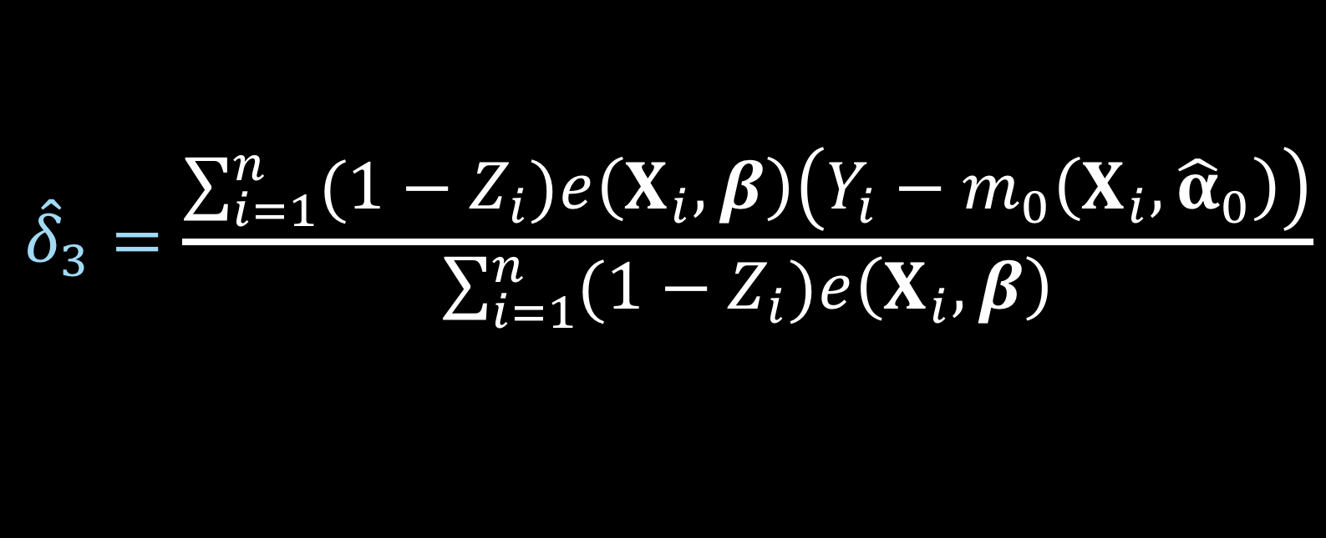
ATO DR estimator
$${\hat{Δ}}_{DR, ATO}={\hat{δ}}_{1}+{\hat{δ}}_{2}−{\hat{δ}}_{3}$$
$${\hat{δ}}_{3}=\frac{\sum_{i=1}^{n}{{(1−Z}_{i})e\left(X_{i},β\right)\left(Y_{i}−m_{0}\left(X_{i},{\hat{α}}_{0}\right)\right)}}{\sum_{i=1}^{n}{{(1−Z}_{i})e\left(X_{i},β\right)}}$$
Notes:
Here is delta 3

Slide 105
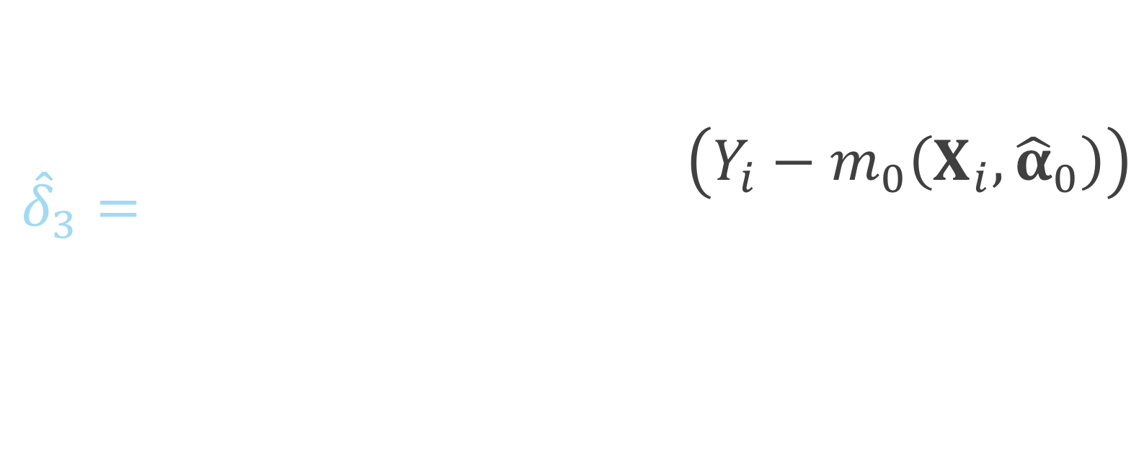
ATO DR estimator
$${\hat{Δ}}_{DR, ATO}={\hat{δ}}_{1}+{\hat{δ}}_{2}−{\hat{δ}}_{3}$$
$${\hat{δ}}_{3}=\frac{\sum_{i=1}^{n}{{(1−Z}_{i})e\left(X_{i},β\right)\left(Y_{i}−m_{0}\left(X_{i},{\hat{α}}_{0}\right)\right)}}{\sum_{i=1}^{n}{{(1−Z}_{i})e\left(X_{i},β\right)}}$$
Notes:
This summation is just among the controls, if the participant is in the treated group, 1 – Zi will be 0

Slide 106
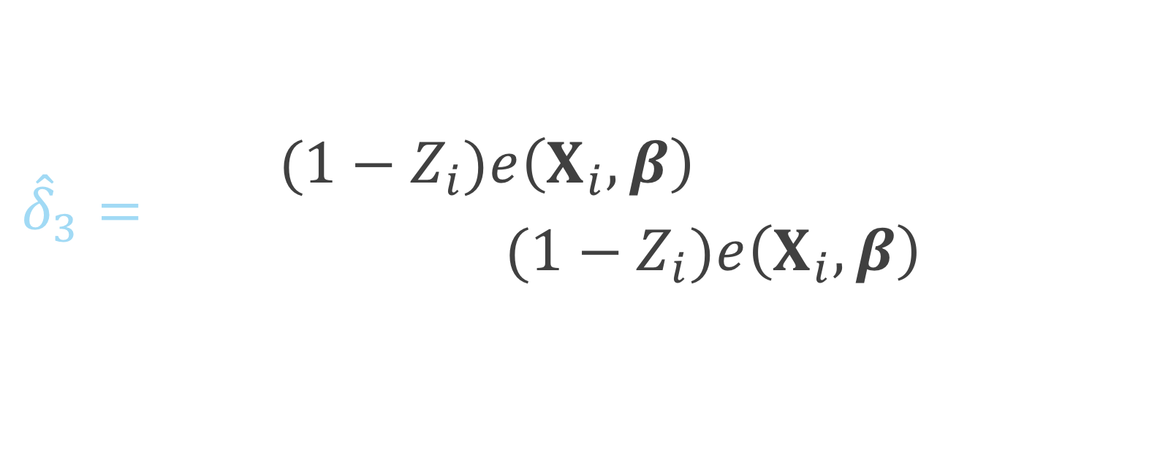
ATO DR estimator
$${\hat{Δ}}_{DR, ATO}={\hat{δ}}_{1}+{\hat{δ}}_{2}−{\hat{δ}}_{3}$$
$${\hat{δ}}_{3}=\frac{\sum_{i=1}^{n}{{(1−Z}_{i})e\left(X_{i},β\right)\left(Y_{i}−m_{0}\left(X_{i},{\hat{α}}_{0}\right)\right)}}{\sum_{i=1}^{n}{{(1−Z}_{i})e\left(X_{i},β\right)}}$$
Notes:
And this is the residual of the observed y among the controls and the predicted y, fit among the controls

Slide 107


ATO DR estimator
$$u\left(θ\right)=\left(\begin{matrix}(m_{1}\left(X, α_{1}\right)−m_{0}\left(X, α_{0}\right)−δ_{1})(Z\left(1−e\left(X,β\right)\right)+\left(1−Z\right)e\left(X,β\right)) \\ \left(Y−m_{1}\left(X, α_{1}\right)−δ_{2}\right)Z(1−e\left(X,β\right)) \\ \begin{aligned}\left(Y−m_{0}\left(X, α_{0}\right)−δ_{3}\right)\left(1−Z\right)e\left(X, β\right) \\ \left(Y−m_{1}\left(X,α_{0}\right)\right)ZX \\ \left(Y−m_{0}\left(X,α_{0}\right)\right)\left(1−Z\right)X \\ X\left(Z−e\left(X,β\right)\right)\end{aligned}\end{matrix}\right)$$
$$θ={\left(δ_{1}, δ_{2},δ_{3},α_{1}^{T},α_{0}^{T},β^{T}\right)}^{T}$$
Notes:
Again this can be solved by simultaneously solving these estimating equations. Note here that this technically will only be correct if both the outcome model AND the propensity score model are correctly specified.

Slide 108

ATO DR estimator
$$u\left(θ\right)=\left(\begin{matrix}(m_{1}\left(X, α_{1}\right)−m_{0}\left(X, α_{0}\right)−δ_{1})(Z\left(1−e\left(X,β\right)\right)+\left(1−Z\right)e\left(X,β\right)) \\ \left(Y−m_{1}\left(X, α_{1}\right)−δ_{2}\right)Z(1−e\left(X,β\right)) \\ \begin{aligned}\left(Y−m_{0}\left(X, α_{0}\right)−δ_{3}\right)\left(1−Z\right)e\left(X, β\right) \\ \left(Y−m_{1}\left(X,α_{0}\right)\right)ZX \\ \left(Y−m_{0}\left(X,α_{0}\right)\right)\left(1−Z\right)X \\ X\left(Z−e\left(X,β\right)\right)\end{aligned}\end{matrix}\right)$$
$$θ={\left(δ_{1}, δ_{2},δ_{3},α_{1}^{T},α_{0}^{T},β^{T}\right)}^{T}$$
Notes:
This is more complicated than the large-sample variance that we derived for the ATO IPW estimator because now we have more parameters to solve for, rather than just mu1, mu0 and beta, we now have delta 1 2 and 3, and alpha 1 and 0 from the outcome models

Slide 109

ATO DR estimator
$$u\left(θ\right)=\left(\begin{matrix}(m_{1}\left(X, α_{1}\right)−m_{0}\left(X, α_{0}\right)−δ_{1})(Z\left(1−e\left(X,β\right)\right)+\left(1−Z\right)e\left(X,β\right)) \\ \left(Y−m_{1}\left(X, α_{1}\right)−δ_{2}\right)Z(1−e\left(X,β\right)) \\ \begin{aligned}\left(Y−m_{0}\left(X, α_{0}\right)−δ_{3}\right)\left(1−Z\right)e\left(X, β\right) \\ \left(Y−m_{1}\left(X,α_{0}\right)\right)ZX \\ \left(Y−m_{0}\left(X,α_{0}\right)\right)\left(1−Z\right)X \\ X\left(Z−e\left(X,β\right)\right)\end{aligned}\end{matrix}\right)$$
$$θ={\left(δ_{1}, δ_{2},δ_{3},α_{1}^{T},α_{0}^{T},β^{T}\right)}^{T}$$
Notes:
These equations incorporate the weights, as seen here

Slide 110

ATO DR estimator
$$u\left(θ\right)=\left(\begin{matrix}(m_{1}\left(X, α_{1}\right)−m_{0}\left(X, α_{0}\right)−δ_{1})(Z\left(1−e\left(X,β\right)\right)+\left(1−Z\right)e\left(X,β\right)) \\ \left(Y−m_{1}\left(X, α_{1}\right)−δ_{2}\right)Z(1−e\left(X,β\right)) \\ \begin{aligned}\left(Y−m_{0}\left(X, α_{0}\right)−δ_{3}\right)\left(1−Z\right)e\left(X, β\right) \\ \left(Y−m_{1}\left(X,α_{0}\right)\right)ZX \\ \left(Y−m_{0}\left(X,α_{0}\right)\right)\left(1−Z\right)X \\ X\left(Z−e\left(X,β\right)\right)\end{aligned}\end{matrix}\right)$$
$$θ={\left(δ_{1}, δ_{2},δ_{3},α_{1}^{T},α_{0}^{T},β^{T}\right)}^{T}$$
Notes:
Notice here we are looking at the difference between the predicted Y among the treated and predicted Y among the controls minus delta1, which is the estimated difference between the two, so when we sum over all participants this will be zero

Slide 111

ATO DR estimator
$$u\left(θ\right)=\left(\begin{matrix}(m_{1}\left(X, α_{1}\right)−m_{0}\left(X, α_{0}\right)−δ_{1})(Z\left(1−e\left(X,β\right)\right)+\left(1−Z\right)e\left(X,β\right)) \\ \left(Y−m_{1}\left(X, α_{1}\right)−δ_{2}\right)Z(1−e\left(X,β\right)) \\ \begin{aligned}\left(Y−m_{0}\left(X, α_{0}\right)−δ_{3}\right)\left(1−Z\right)e\left(X, β\right) \\ \left(Y−m_{1}\left(X,α_{0}\right)\right)ZX \\ \left(Y−m_{0}\left(X,α_{0}\right)\right)\left(1−Z\right)X \\ X\left(Z−e\left(X,β\right)\right)\end{aligned}\end{matrix}\right)$$
$$θ={\left(δ_{1}, δ_{2},δ_{3},α_{1}^{T},α_{0}^{T},β^{T}\right)}^{T}$$
Notes:
Here we are taking the observed Y minus the predicted Y among the treated minus delta 2

Slide 112

ATO DR estimator
$$u\left(θ\right)=\left(\begin{matrix}(m_{1}\left(X, α_{1}\right)−m_{0}\left(X, α_{0}\right)−δ_{1})(Z\left(1−e\left(X,β\right)\right)+\left(1−Z\right)e\left(X,β\right)) \\ \left(Y−m_{1}\left(X, α_{1}\right)−δ_{2}\right)Z(1−e\left(X,β\right)) \\ \begin{aligned}\left(Y−m_{0}\left(X, α_{0}\right)−δ_{3}\right)\left(1−Z\right)e\left(X, β\right) \\ \left(Y−m_{1}\left(X,α_{0}\right)\right)ZX \\ \left(Y−m_{0}\left(X,α_{0}\right)\right)\left(1−Z\right)X \\ X\left(Z−e\left(X,β\right)\right)\end{aligned}\end{matrix}\right)$$
$$θ={\left(δ_{1}, δ_{2},δ_{3},α_{1}^{T},α_{0}^{T},β^{T}\right)}^{T}$$
Notes:
The observed Y among the controls minus the predicted minus delta 3

Slide 113

ATO DR estimator
$$u\left(θ\right)=\left(\begin{matrix}(m_{1}\left(X, α_{1}\right)−m_{0}\left(X, α_{0}\right)−δ_{1})(Z\left(1−e\left(X,β\right)\right)+\left(1−Z\right)e\left(X,β\right)) \\ \left(Y−m_{1}\left(X, α_{1}\right)−δ_{2}\right)Z(1−e\left(X,β\right)) \\ \begin{aligned}\left(Y−m_{0}\left(X, α_{0}\right)−δ_{3}\right)\left(1−Z\right)e\left(X, β\right) \\ \left(Y−m_{1}\left(X,α_{0}\right)\right)ZX \\ \left(Y−m_{0}\left(X,α_{0}\right)\right)\left(1−Z\right)X \\ X\left(Z−e\left(X,β\right)\right)\end{aligned}\end{matrix}\right)$$
$$θ={\left(δ_{1}, δ_{2},δ_{3},α_{1}^{T},α_{0}^{T},β^{T}\right)}^{T}$$
Notes:
The observed Y minus the predicted Y among the treated

Slide 114

ATO DR estimator
$$u\left(θ\right)=\left(\begin{matrix}(m_{1}\left(X, α_{1}\right)−m_{0}\left(X, α_{0}\right)−δ_{1})(Z\left(1−e\left(X,β\right)\right)+\left(1−Z\right)e\left(X,β\right)) \\ \left(Y−m_{1}\left(X, α_{1}\right)−δ_{2}\right)Z(1−e\left(X,β\right)) \\ \begin{aligned}\left(Y−m_{0}\left(X, α_{0}\right)−δ_{3}\right)\left(1−Z\right)e\left(X, β\right) \\ \left(Y−m_{1}\left(X,α_{0}\right)\right)ZX \\ \left(Y−m_{0}\left(X,α_{0}\right)\right)\left(1−Z\right)X \\ X\left(Z−e\left(X,β\right)\right)\end{aligned}\end{matrix}\right)$$
$$θ={\left(δ_{1}, δ_{2},δ_{3},α_{1}^{T},α_{0}^{T},β^{T}\right)}^{T}$$
Notes:
The observed Y minus the predicted among the controls

Slide 115

ATO DR estimator
$$u\left(θ\right)=\left(\begin{matrix}(m_{1}\left(X, α_{1}\right)−m_{0}\left(X, α_{0}\right)−δ_{1})(Z\left(1−e\left(X,β\right)\right)+\left(1−Z\right)e\left(X,β\right)) \\ \left(Y−m_{1}\left(X, α_{1}\right)−δ_{2}\right)Z(1−e\left(X,β\right)) \\ \begin{aligned}\left(Y−m_{0}\left(X, α_{0}\right)−δ_{3}\right)\left(1−Z\right)e\left(X, β\right) \\ \left(Y−m_{1}\left(X,α_{0}\right)\right)ZX \\ \left(Y−m_{0}\left(X,α_{0}\right)\right)\left(1−Z\right)X \\ X\left(Z−e\left(X,β\right)\right)\end{aligned}\end{matrix}\right)$$
$$θ={\left(δ_{1}, δ_{2},δ_{3},α_{1}^{T},α_{0}^{T},β^{T}\right)}^{T}$$
Notes:
Finally the estimating equation for the propensity score model

Slide 116
Sandwich estimator
$$var\left(θ\right)=A^{−1}BA^{−T}$$
Notes:
Again, we are using the sandwich estimator to approximate the large sample variance

Slide 117

ATO DR estimator
$${\hat{Δ}}_{DR, ATO}={\hat{δ}}_{1}+{\hat{δ}}_{2}−{\hat{δ}}_{3}$$
$$var\left({\hat{Δ}}_{DR, ATO}\right)=\left(1 1 −1 0 0 0\right){\frac{1}{n}\hat{A}}_{n}^{−1} {\hat{B}}_{n}{\hat{A}}_{n}^{−T}\left({1 \atop \begin{aligned}1 \\ −1 \\ 0 \\ 0 \\ 0\end{aligned}}\right)$$
Notes:
Because we are estimating delta 1 plus delta 2 minus delta 3, after we estimate our sandwich estimator

Slide 118

ATO DR estimator
$${\hat{Δ}}_{DR, ATO}={\hat{δ}}_{1}+{\hat{δ}}_{2}−{\hat{δ}}_{3}$$
$$var\left({\hat{Δ}}_{DR, ATO}\right)=\left(1 1 −1 0 0 0\right){\frac{1}{n}\hat{A}}_{n}^{−1} {\hat{B}}_{n}{\hat{A}}_{n}^{−T}\left({1 \atop \begin{aligned}1 \\ −1 \\ 0 \\ 0 \\ 0\end{aligned}}\right)$$
Notes:
This will be our variance estimator where

Slide 119

ATO DR estimator
$${\hat{Δ}}_{DR, ATO}={\hat{δ}}_{1}+{\hat{δ}}_{2}−{\hat{δ}}_{3}$$
$$\hat{var}\left({\hat{Δ}}_{DR, ATO}\right)=\left(1 1 −1 0 0 0\right){\frac{1}{n}\hat{A}}_{n}^{−1} {\hat{B}}_{n}{\hat{A}}_{n}^{−T}\left({1 \atop \begin{aligned}1 \\ −1 \\ 0 \\ 0 \\ 0\end{aligned}}\right)$$
Notes:
We will multiply by the vector 1 1 -1 with the remaining entries 0 on both sides

Slide 120

ATO DR estimator
$${\hat{Δ}}_{DR, ATO}={\hat{δ}}_{1}+{\hat{δ}}_{2}−{\hat{δ}}_{3}$$
$$var\left({\hat{Δ}}_{DR, ATO}\right)=\left(1 1 −1 0 0 0\right){\frac{1}{n}\hat{A}}_{n}^{−1} {\hat{B}}_{n}{\hat{A}}_{n}^{−T}\left({1 \atop \begin{aligned}1 \\ −1 \\ 0 \\ 0 \\ 0\end{aligned}}\right)$$
Notes:
Of our estimated sandwich variance to approximate the variance of this quantity

Slide 121
Freedman & Berk* Simulation

Slide 122
correct-correct correct-wrong wrong-correct wrong-wrong
Notes:
We have 4 settings, and in fact we actually have 6, because we observe 3 different settings in the wrong-wrong case

Slide 123
correct-correct correct-wrong wrong-correct wrong-wrong

Slide 124
correct-correct correct-wrong wrong-correct wrong-wrong

Slide 125
correct-correct correct-wrong wrong-correct wrong-wrong

Slide 126
correct-correct correct-wrong wrong-correct wrong-wrong
extreme
moderate
slight

Slide 127
bias ratio estimated se / true se RMSE 95% coverage

Slide 128
bias ratio estimated se / true se RMSE 95% coverage

Slide 129
Continuous outcome

Slide 130

Simulation
$$X \sim MVN\left(\left({0.5 \atop 1}\right), \left(\begin{matrix}2 & 1 \\ 1 & 1\end{matrix}\right)\right)$$
$$V \sim N \left(0, 1\right)$$
$$Z=\left\{\begin{aligned}1 0.5+0.25X_{1}+0.75X_{2}+V>0 \\ &0 o.w.\end{aligned}\right.$$
$$U \sim N(0, 1)$$
$$Y=1+Z+X_{1}+3X_{2}+U$$

Slide 131

Simulation
$$X \sim MVN\left(\left({0.5 \atop 1}\right), \left(\begin{matrix}2 & 1 \\ 1 & 1\end{matrix}\right)\right)$$
$$V \sim N \left(0, 1\right)$$
$$Z=\left\{\begin{aligned}1 0.5+0.25X_{1}+0.75X_{2}+V>0 \\ &0 o.w.\end{aligned}\right.$$
$$U \sim N(0, 1)$$
$$Y=1+Z+X_{1}+3X_{2}+U$$

Slide 132
correct-correct

Slide 133
correct-correct

Slide 134
correct-wrong

Slide 135
correct-wrong

Slide 136
wrong-correct

Slide 137
wrong-correct

Slide 138
wrong-wrong

Slide 139
wrong-wrong

Slide 140
wrong-wrong

Slide 141
wrong-wrong
Notes:
Even here, in a less extreme case (we’ve made the size of the unmeasured confounder pretty small) you still see by the time N = 5000, the bias fully takes over the variance, pulling the coverage to 0.

Slide 142
Recap
Derived the DR estimator and large sample variance for ATO
Compared to conventional methods
When the outcome model is correctly specified, robust standard errors obtained from a generalized linear model perform well, otherwise our large-sample variance is preferred
If a confounder is completely left out, we need alternative methods to adjust for the bias

Slide 143
Q&A

Slide 144
Contextualized Tipping Point Sensitivity Analyses for Unmeasured Confounding

Slide 145
Meaningful confounders
1. How imbalanced is the confounder between the exposure groups?
2. How predictive is the confounder of the outcome?

Slide 146

Standardized mean difference
$$d=\frac{{\overline{x}}_{exposed}−{\overline{x}}_{unexposed}}{\sqrt{\frac{s_{exposed}^{2}+s_{unexposed}^{2}}{2}}}$$

Slide 147
Imbalance between exposures
Love Plots

Slide 148
Standardized Mean Difference
library(tidyr)
plot_df <- data.frame(
var = names(ExtractSmd(smd_table)),
Unadjusted = ExtractSmd(smd_table_unweighted ),
Weighted = ExtractSmd(smd_table)) %>%
gather("Method", "SMD", -var)

Slide 149
Standardized Mean Difference
library(ggplot2)
ggplot(
data = plot_df,
mapping = aes(x = var, y = SMD, group = Method, color = Method)
) +
geom_line() +
geom_point() +
geom_hline(yintercept = 0.1, color = "black", size = 0.1) +
coord_flip()

Slide 150
Love Plots

Slide 151
Outcome model
svyglm(
outcome ~ exposure,
data = svy_des,
family = binomial)

Slide 152
Outcome model
svyglm(
outcome ~ exposure,
data = svy_des,
family = binomial) %>%
confint(parm = “exposure”)

Slide 153
Outcome model
svyglm(
outcome ~ exposure,
data = svy_des,
family = binomial) %>%
confint(parm = “exposure”) %>%
exp()
#> 2.5% 97.5%
#> exposure 1.51 2.01

Slide 154
unmeasured confounding

Slide 155
All you need
Exposure-outcome effect
Exposure-unmeasured confounder effect
Outcome-unmeasured confounder effect

Slide 156
All you need
Exposure-outcome effect generally estimated from a model, for example an odds ratio, hazard ratio, or risk ratio
Exposure-unmeasured confounder effect
Outcome-unmeasured confounder effect
Odds Ratio Confidence Interval: (1.5, 2)

Slide 157
All you need
Exposure-outcome effect generally estimated from a model, for example an odds ratio, hazard ratio, or risk ratio
Exposure-unmeasured confounder effect
Outcome-unmeasured confounder effect

Slide 158

Tipping point analyses
what will tip our confidence bound to cross 1

Slide 159
All you need
Exposure-outcome effect generally estimated from a model, for example an odds ratio, hazard ratio, or risk ratio
Exposure-unmeasured confounder effect can use my observed variables to estimate this
Outcome-unmeasured confounder effect

Slide 160
All you need
Exposure-outcome effect generally estimated from a model, for example an odds ratio, hazard ratio, or risk ratio
Exposure-unmeasured confounder effect can use my observed variables to estimate this
Outcome-unmeasured confounder effect

Slide 161
Exposure-unmeasured confounder effect
Prevalence of the unmeasured confounder among the exposed
Prevalence of the unmeasured confounder among the unexposed

Slide 162


$p_{0}=0.1$
$$p_{1}=0.3$$
Love Plots

Slide 163
Confounding
Confounder
$p_{0}=0.1$
?
$$p_{1}=0.3$$
Exposure
Outcome
Odds Ratio Confidence Interval: (1.5, 2)

Slide 164
Standardized Mean Difference
library(tipr)
tip_with_binary(
p0 = 0.1,
p1 = 0.3,
lb = 1.5,
ub = 2)

Slide 165
Standardized Mean Difference
library(tipr)
tip_with_binary(
p0 = 0.1,
p1 = 0.3,
lb = 1.5,
ub = 2)
#> [1] 4.333333

